Slide 1
TRAINING: DRESS CODE, BLUEPRINT AND MARKING FORMAT
DATE: 3/5/25

Slide 2
THE DRESS CODE
Not Allowed:
Flared palazzo
Skin tight narrow trousers
Short length shirts
Open Pallu of Saree
Casual Tops/ T-shirts
Sleeveless kurta/shirt
Open slippers
Long dangling earrings
Tingling Anklets/Bangles/Dupatta/Stoles/ Scarfs
Long nails
Long open hairs
Mixing Indian and Western wear

Slide 3
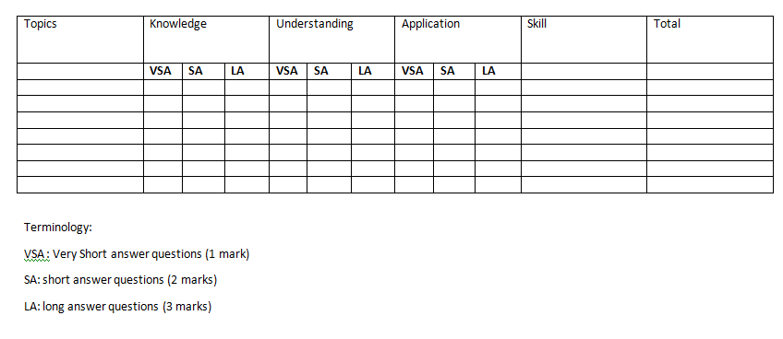
UNDERSTANDING BLUEPRINT

Slide 4
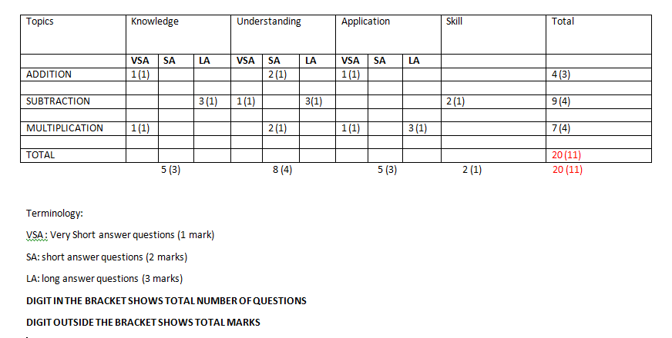
EXAMPLE:

Slide 5
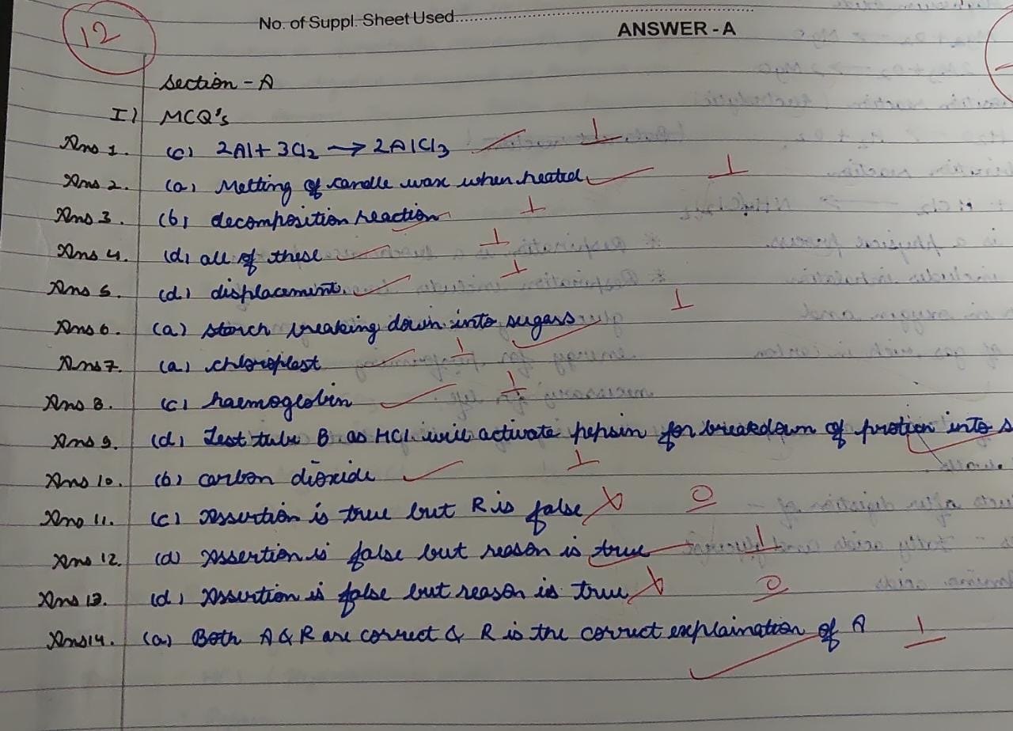
MARKING FORMAT

Slide 6
STUDENT LED PMI
MOTIVE
GRADES 3 AND ABOVE
GOAL SETTING
TO BE DISCUSSED DURING CLASS MENTOR’S LAST PERIOD
GOALS TO BE RECORDED IN THE ANECDOTAL BOOK

