Slide 1
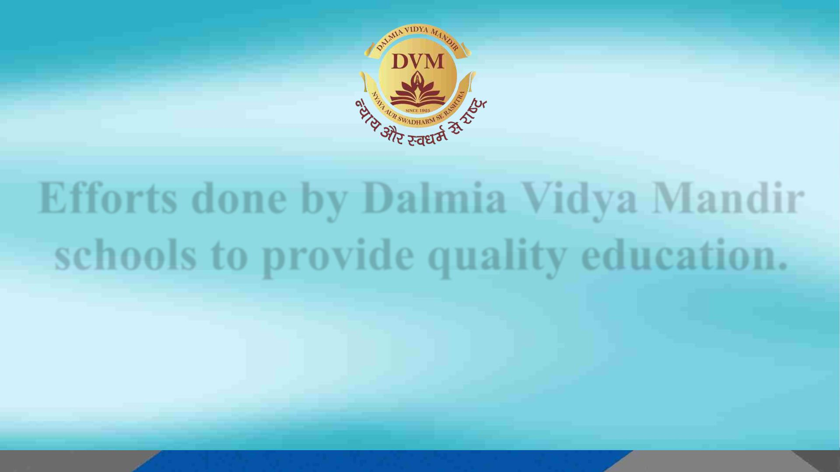
Efforts done by Dalmia Vidya Mandir
schools to provide quality education.
By.
Dr. Rosetta Williams
Chief Education Officer.
Group Head- Education Vertical, Pan India.
Dalmia Vidya Mandir Schools.

Slide 2

The educational institution has made noteworthy
strides in the pursuit of its objectives.
BHARAT GAURAV
YATRA
CBSE SCHOOLS
All Dalmia Vidya
Mandir Schools
NATIONAL
INSTITUTE OF OPEN
SCHOOLING
STATE BOARD
SCHOOLS
Dalmia Vidya Mandir,
Chirawa
Bal Bharti School,
Bahadurgarh
Company High School,
Kalyanpur
Dalmia Vidya Mandir,
Dalmiapuram
Dalmia Vidya Mandir,
Dalmiapuram
Dalmia Public School,
Sutrapada
Dalmia Higher
Secondary School,
Dalmiapuram
Dalmia Vidya Mandir,
Chirawa (Af)
Dalmia Vidya Mandir,
Rajgangpur
Akshya Pratishthan,
New Delhi
(Dalmia Initiative For
Special Children)
Dalmia Vidya Mandir,
Rajgangpur (Af)

Slide 3

Efforts, standards, and strategies aimed at implementing a
comprehensive approach to delivering high-quality
education.
ü The school has implemented a comprehensive approach to standardizing every facet of education, including the development of a logo,
motto, and website.
ü Standard Operating Procedure manuals have been written, along with Bylaws and Policies.
ü The school has implemented a Uniform policy to promote brand building.
ü Intensive exam coaching has been provided, resulting in excellent Board results.
ü Building Renovations have been undertaken
ü The school has introduced ERP, LMS, and Smart Classes.
ü Staff appraisal and training are ongoing, with a requirement of 60 hours per annum.
ü The school is financially self-sufficient
ü The Bharat Gaurav Yatra curriculum has been introduced, along with an oral Sanskrit curriculum from Nursery.
ü Implementation of Dalmia Core promises in curriculum.
ü The coordination of G20 activities has been instrumental in driving the transformation plan for students' academic excellence.
ü The alumni program has been established to connect former students with the new generation.
ü The school has also initiated the Gau Roti Bin project, along with green school projects, tree plantation, and other environmental initiatives.
ü Coaching classes have been organized to prepare students for entrance examinations.
ü CBSE Affiliation and setting up of National School of Open Learning(NIOS).
ü Students have been incentivized to engage in national and local contests, as well as ISRO and RDC camps.
ü The expansion of the education vertical has led to the opening of new schools in remote areas, and infrastructure development has been a top
priority.
ü Teachers are undergoing a 60-hour training session to keep them updated with new trends.
ü The school has been certified with SQAA as a dynamic and evolving CBSE school.

Slide 4
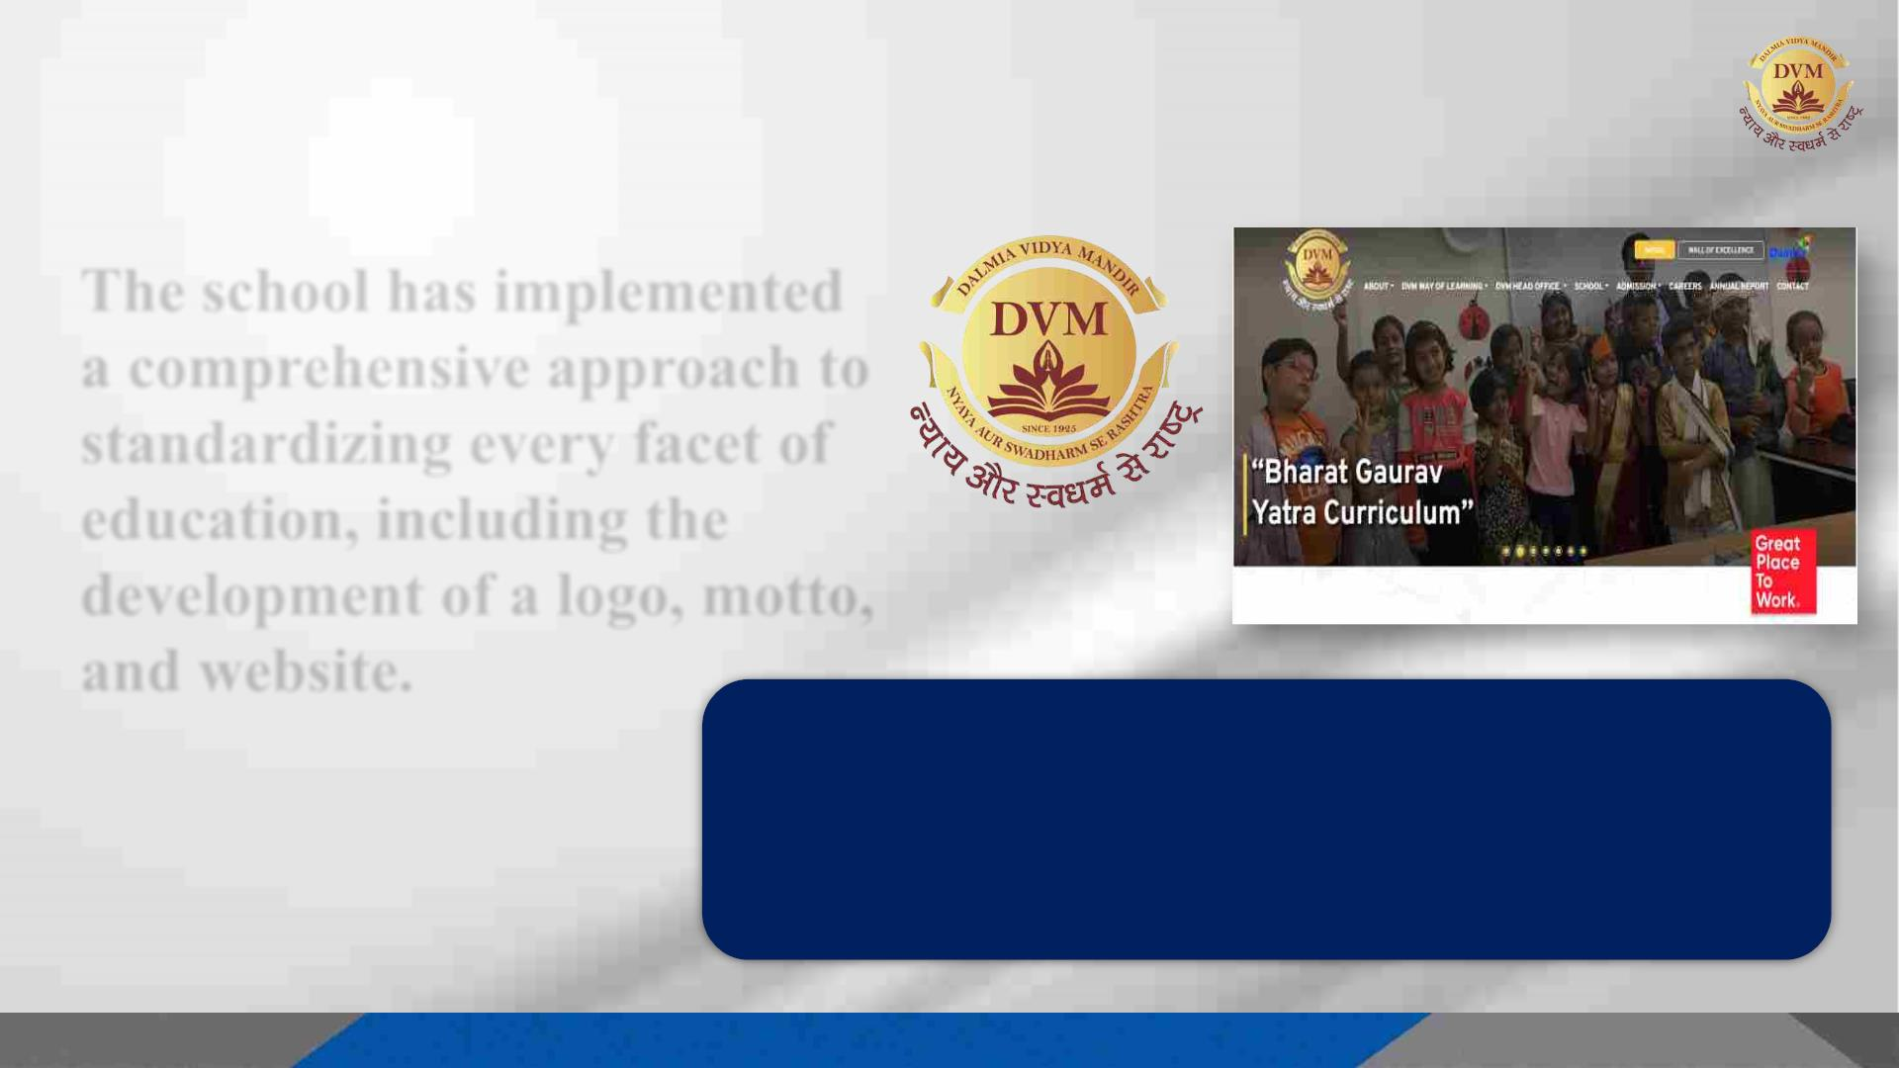
The school has implemented
a comprehensive approach to
standardizing every facet of
education, including the
development of a logo, motto,
and website.
Mission:
To stimulate and nurture young minds which strive for excellence through active learning.
To enable children to become thoughtful, sensitive and respectful global citizens with a progressive
outlook.
Vision:
To provide accessible, affordable and contemporary education for harmonious development of mind,
body and soul with a deep-rooted value system.

Slide 5
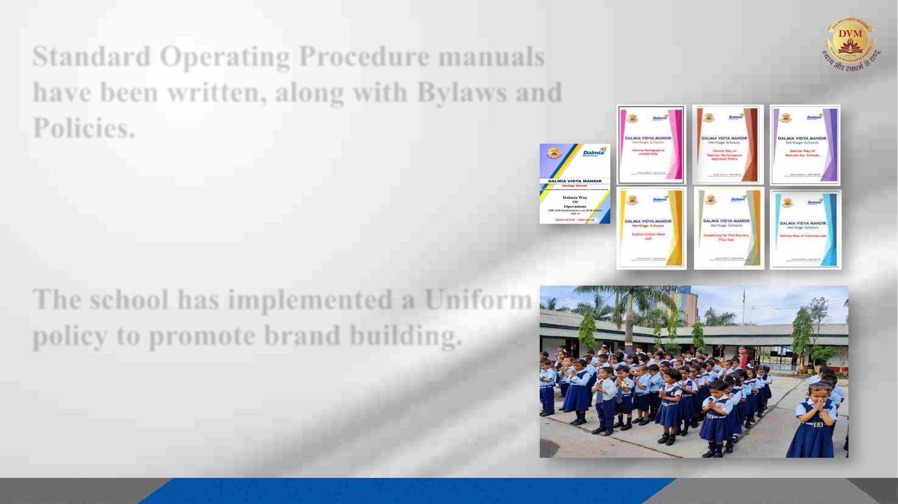
Standard Operating Procedure manuals
have been written, along with Bylaws and
Policies.
The Standard Operating Procedures (SOPs) are
comprehensive manuals that outline the
methodologies and plans for the day-to-day
operations of a school..
The school has implemented a Uniform
policy to promote brand building.
A standardized uniform has been proposed for all
verticals of Dalmia Vidya Mandir school, with the aim
of implementing uniformity through the use of
uniforms.

Slide 6
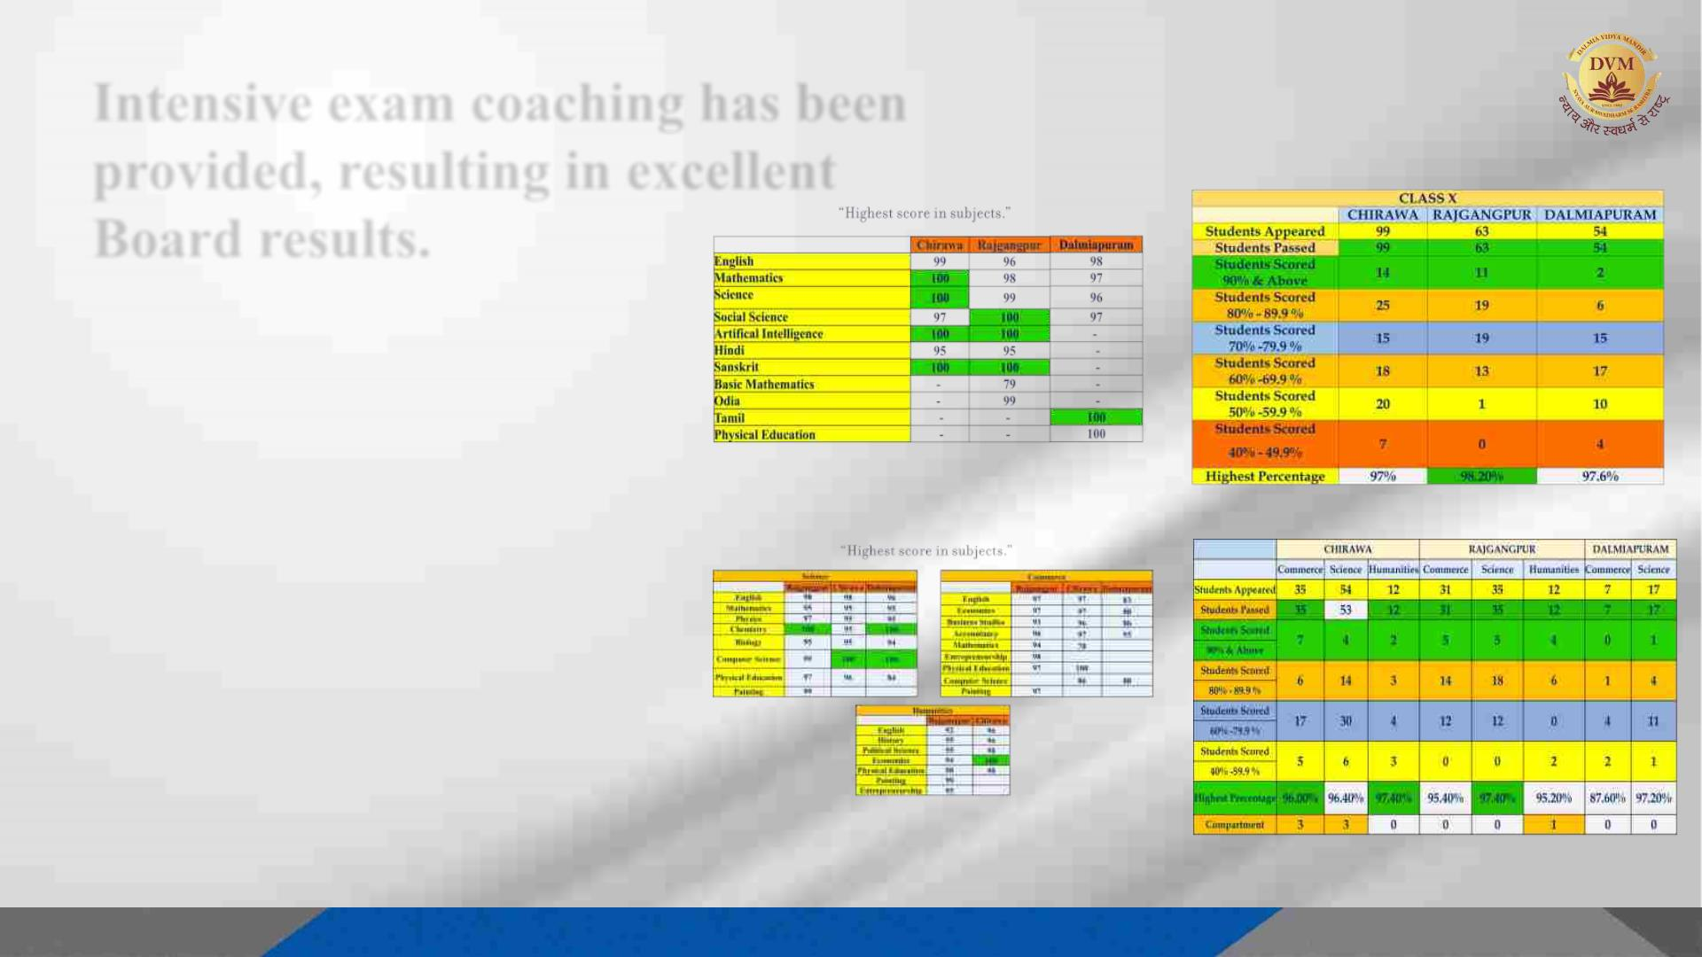
Intensive exam coaching has been
provided, resulting in excellent
Board results.
By employing a personalized and
intensive teaching approach,
coupled with the execution of a
comprehensive transformation
strategy, we have attained
exceptional board results. Our
students have achieved a 1st
division score, leading to a
remarkable success rate of 100%.

Slide 7

Building Renovations have been undertaken
Renovations have been carried
out on the school buildings,
resulting in a refreshed and
standardized appearance, thereby
elevating the overall quality of
the educational facilities.
The school has introduced ERP, LMS, and Smart Classes.
The implementation of ERP, LMS,
and Smart Classes has ushered in a
wave of digitization in schools,
rendering them future-ready and
equipped to keep pace with the
rapidly evolving world of education.

Slide 8
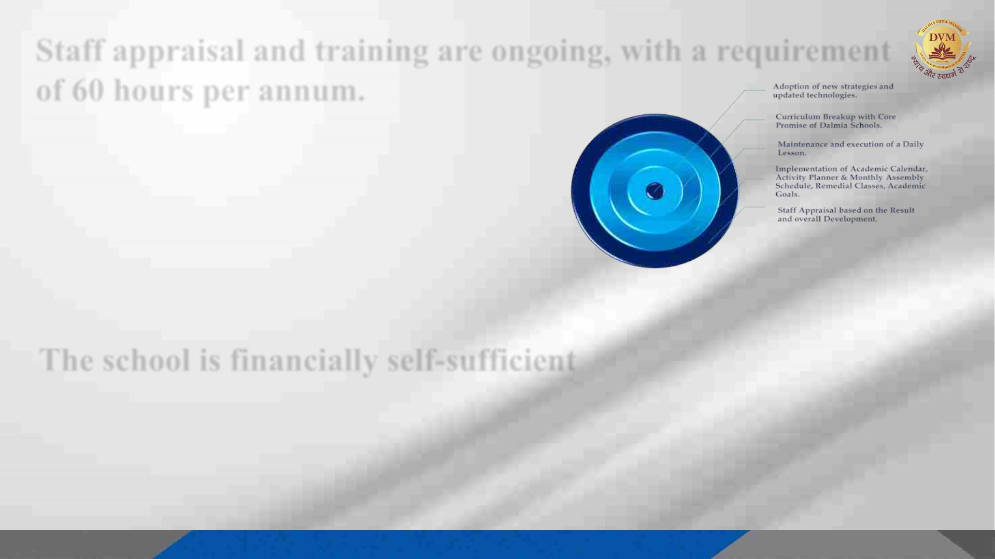
Staff appraisal and training are ongoing, with a requirement
of 60 hours per annum.
The staff appraisal process was closely aligned
with various factors, including staff
performance outcomes, the transformation
plan, curriculum planning, activity calendars,
remedial classes, and other relevant
considerations.
The school is financially self-sufficient
The majority of our schools operate with financial independence and maintain a surplus.
The remuneration of teachers and fulfillment of basic school requirements are achieved
without external support.

Slide 9
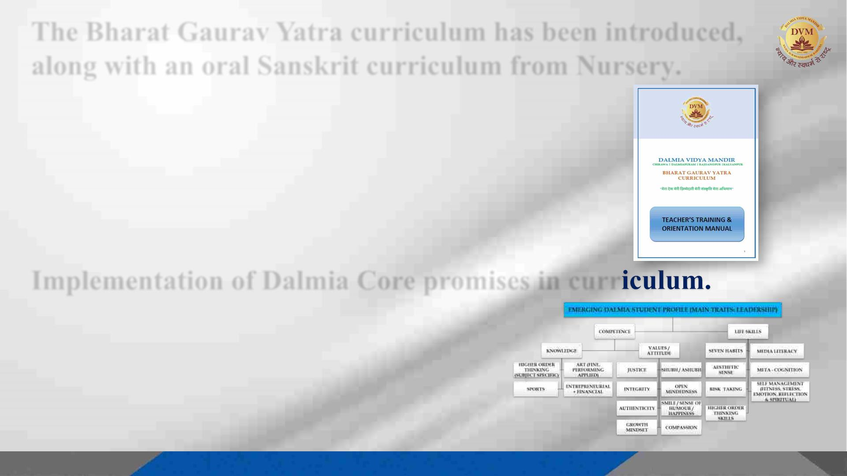
The Bharat Gaurav Yatra curriculum has been introduced,
along with an oral Sanskrit curriculum from Nursery.
With the guidance and support of our esteemed visionaries,
the DVM team has undertaken a special initiative known as
the "BHARAT GAURAV YATRA CURRICULUM" to foster
and instill a sense of patriotism and nationalism among both
teachers and students. Additionally, the introduction of
Sanskrit curriculum in schools aims to raise awareness of our
ancestral language among children.
Implementation of Dalmia Core promises in curr
The curriculum of the school syllabus
incorporates the 19 parameters of Dalmia Core
Promises, with a primary focus on leadership, to
instill essential values in the students.

Slide 10
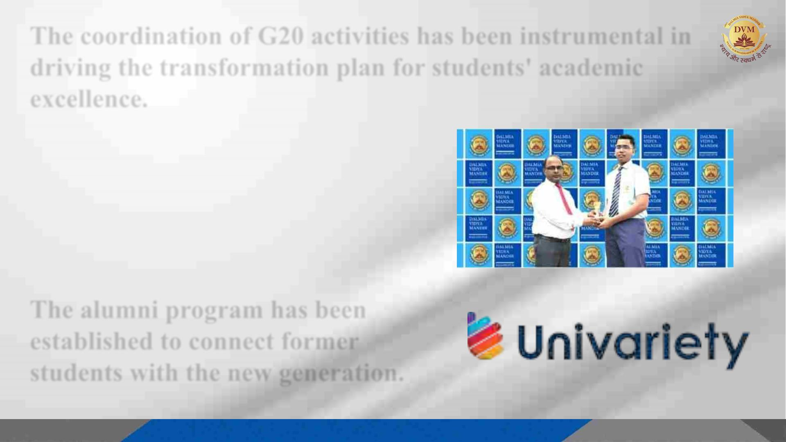
The coordination of G20 activities has been instrumental in
driving the transformation plan for students' academic
excellence.
Master Somyakant Rout, a Class 10
student from Dalmia Vidya Mandir in
Rajgangpur, has been recognized as one
of the top performers in the CBSE
Science Challenge 2023-24, which was a
component of the G20 initiative.
The alumni program has been
established to connect former
students with the new generation.

Slide 11
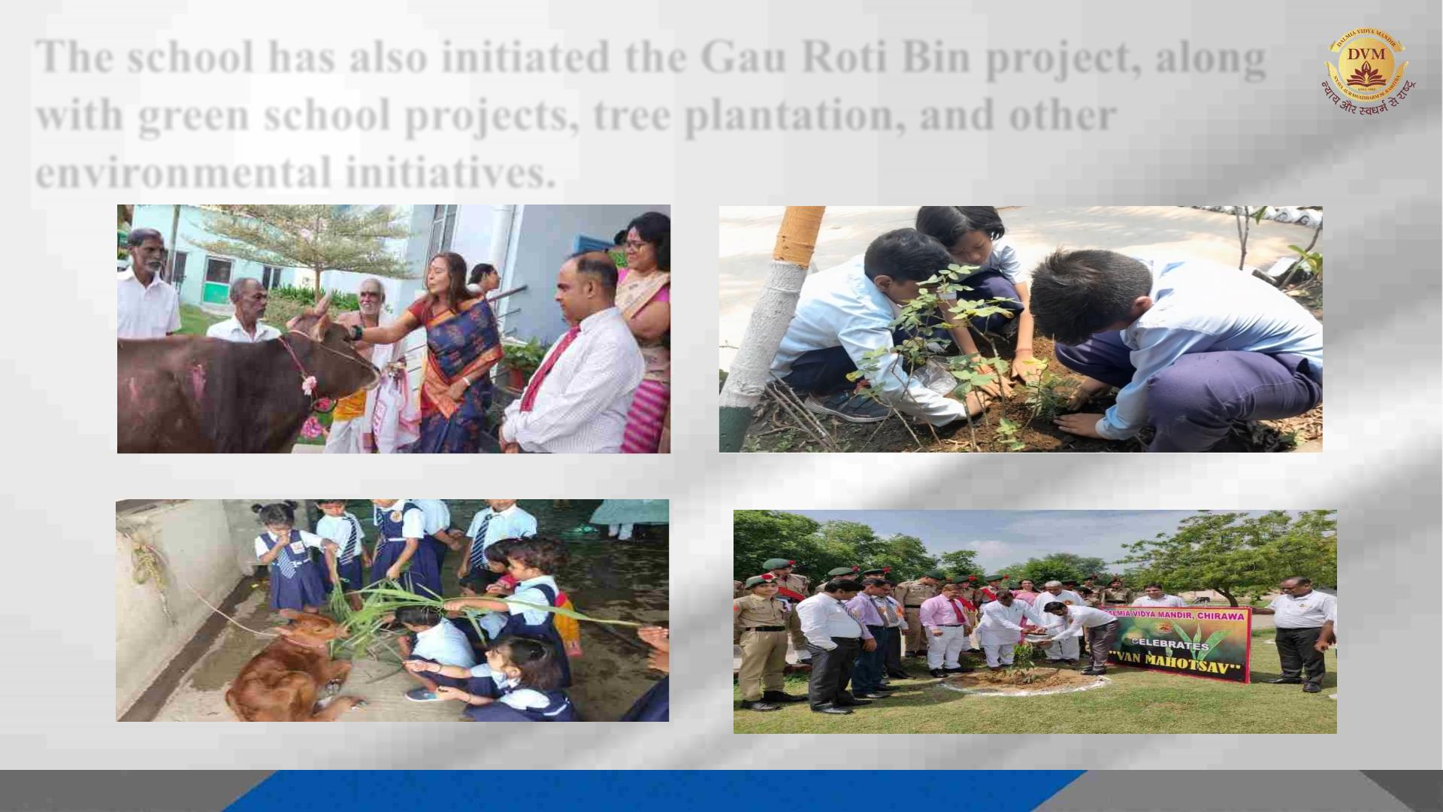
The school has also initiated the Gau Roti Bin project, along
with green school projects, tree plantation, and other
environmental initiatives.
Gau Puja DVM, Dalmiapuram
Tree plantation DVM Thangskai
Gaushala visit DVM Kadapa
Van Mahotsav DVM Rajgangpur

Slide 12
The school has also initiated the Gau Roti Bin project, along
with green school projects, tree plantation, and other
environmental initiatives.
Gau Puja DVM, Dalmiapuram
Tree plantation DVM Thangskai
Gaushala visit DVM Kadapa
Van Mahotsav DVM Rajgangpur

Slide 13
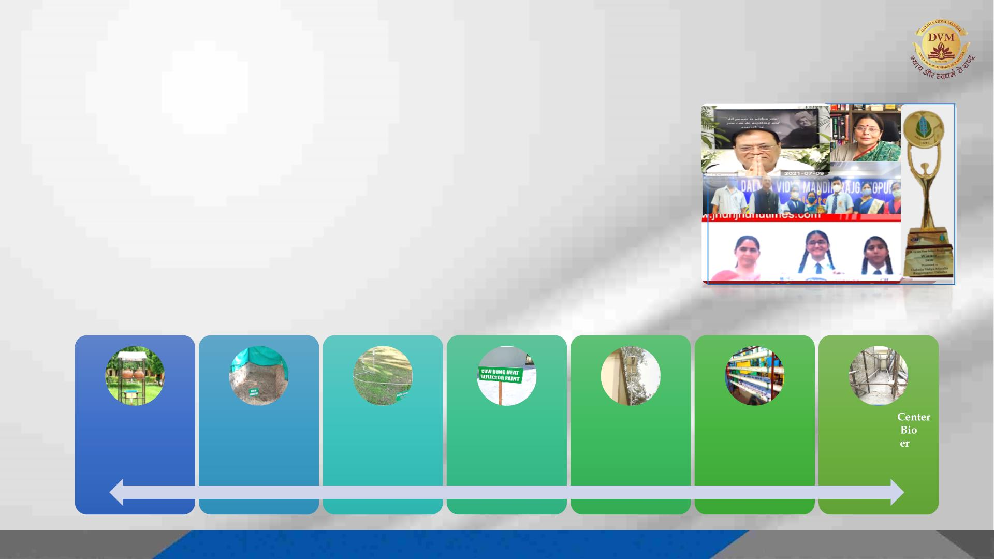
GREEN SCHOOL INITIATIVES/PROJECTS
Dalmia Vidya Mandir recently celebrated a momentous achievement, thanks to the inspiration
provided by our Group Promoters and the guidance of our esteemed CEO-DVM, Dr. Rosetta
Williams. With the unwavering support of the Dalmia Bharat Group team, we are proud to have
been recognized as winners in the Innovation Category at the Green Your School Programme
2020. This prestigious accolade was bestowed upon us during a virtual grand award ceremony
organized by the Indian Green Building Council (IGBC), further adding to the glory of our
esteemed institution.
Winners:
~ Dalmia Vidya Mandir, Rajgangpur – First Prize.
-
Cash Prize - 4 Lacs
~ Dalmia Vidya Mandir, Chirawa – Fifth Prize.
Cash Prize - 1.5 Lacs
-
Manure from
Biodegradable
Waste
Hydroponics
System Under
Construction
Bamboo Skill
and Combo
Toilet und
Construction
@ DVM Rajgangpur
Earthen Pots Water
Cooler
@ DVM Chirawa
Water Sprinkler
System
@ DVM Chirawa
Cow Dung Heat
Reflector Paint
@DVM Chirawa
Solar Street Lights
@ DVM Rajgangpur
@ DVM Chirawa
@ DVM Rajgangpur
13

Slide 14
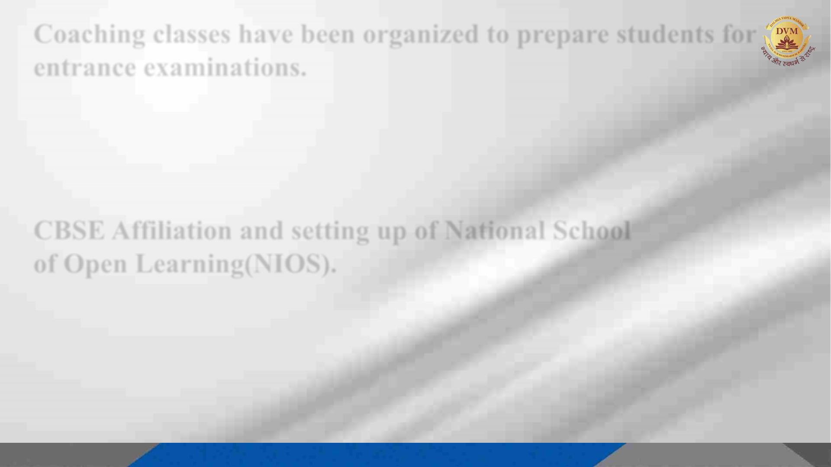
Coaching classes have been organized to prepare students for
entrance examinations.
Coaching classes have been introduced in schools catering to students preparing for
preparatory or entrance exams, with the aim of equipping them for board exams. DVM
schools located in Dalmiapuram, Rajgangpur, and Chirawa have taken the initiative to
prepare their students for these exams by introducing external coaching teams to
conduct additional classes within the school premises.
CBSE Affiliation and setting up of National School
of Open Learning(NIOS).
DVM, Dalmiapuram has undergone a conversion to the Central Board of Secondary
Education (CBSE) curriculum till 2029. Additionally, two existing schools have been
extended, and plans are underway to establish three new schools. Furthermore, National
Institute of Open Schooling (NIOS) centers have been opened in DVM Dalmiapurma and
Chirawa, with plans for another center in Rajgangpur currently in progress.

Slide 15
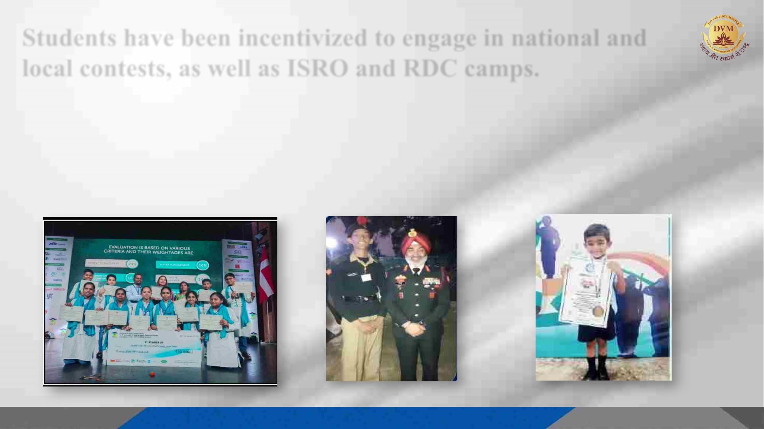
Students have been incentivized to engage in national and
local contests, as well as ISRO and RDC camps.
Dalmia Vidya Mandir, located in Dalmiapuram, achieved the runner-up position in the
National Level Nukkad Natak Competition by GRIHA. Furthermore, Master Ankan Saxena
from Dalmia Vidya Mandir Chirawa participated in the RDC Camp in Delhi and attended the
Space Camp by ISRO. Additionally, Master Ayansh Das claimed the International World
Record (IBR) for Rhymes.
DVM,Dalmiapuram in Nukkad Natak
Master Ankan Saxena, DVM Chirawa Master Ayansh Das, DVM Rajgangpur

Slide 16
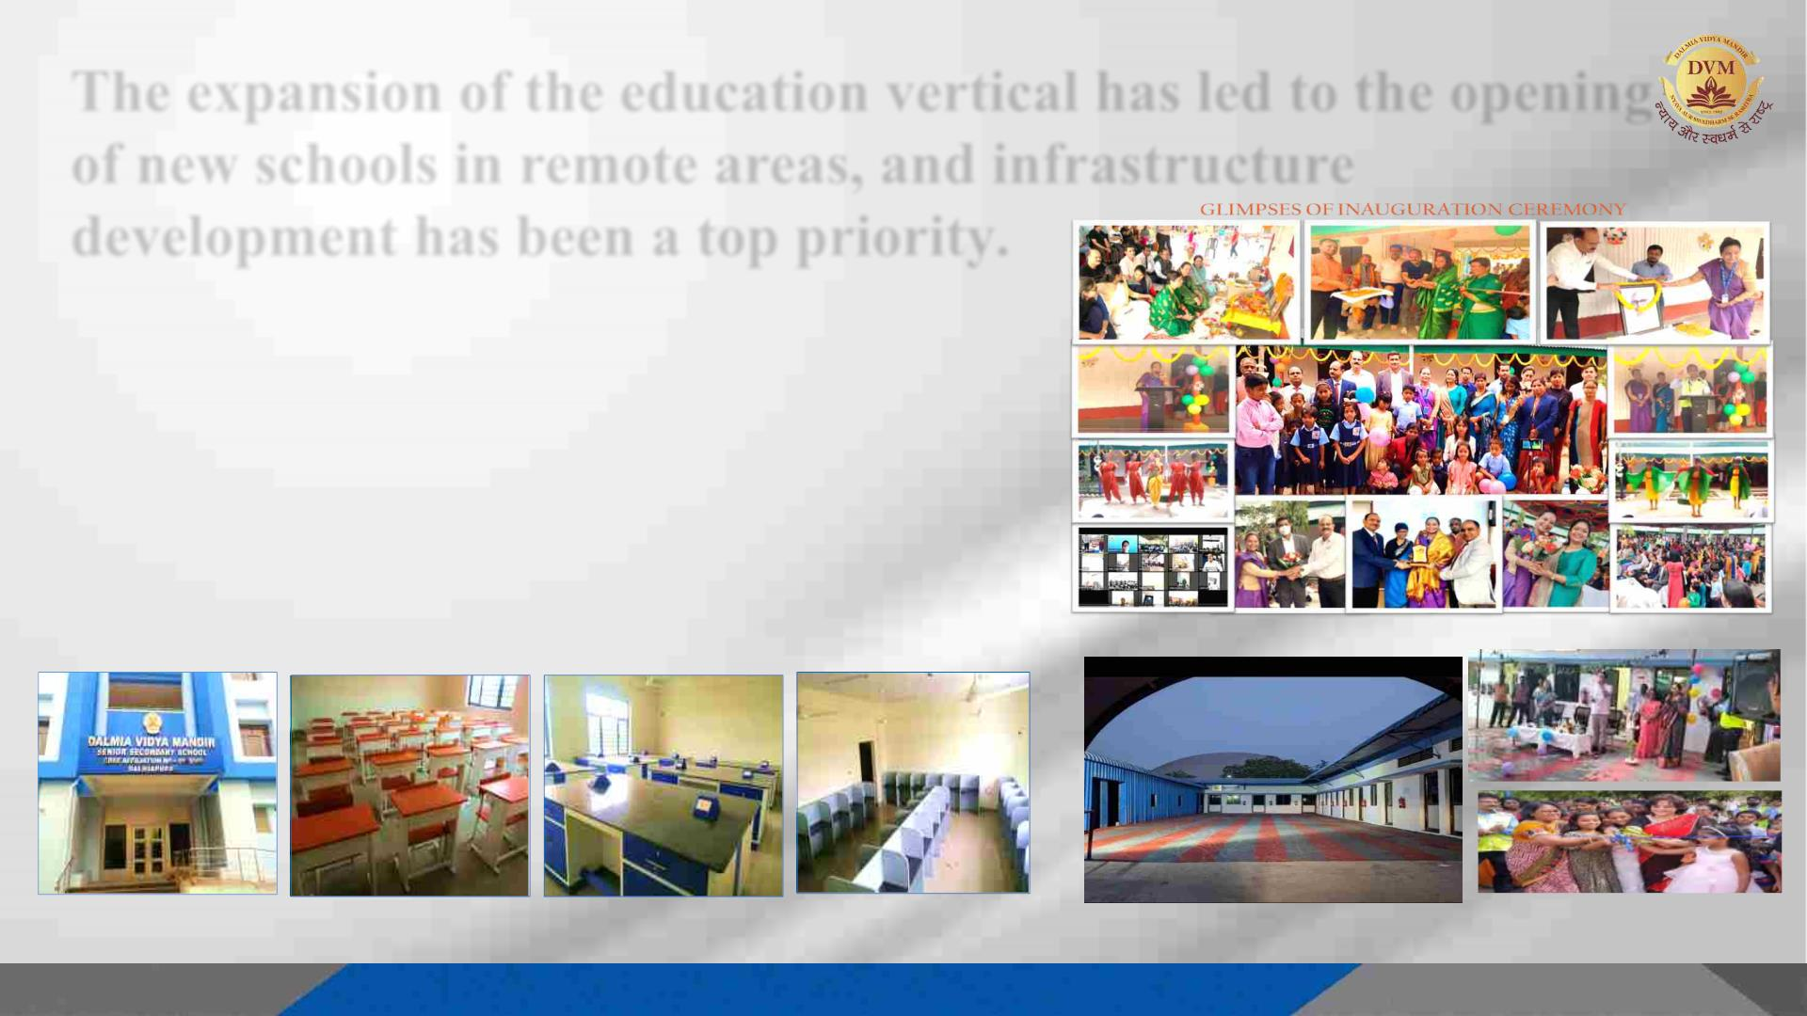
The expansion of the education vertical has led to the opening
of new schools in remote areas, and infrastructure
development has been a top priority.
Our organization is committed to delivering quality education
to the remote regions of India. As part of this mission, we are
consistently expanding our reach to the underdeveloped areas
of Meghalaya, Umaransoo, and Lanka, with the objective of
establishing new schools and enhancing the existing ones with
state-of-the-art facilities to ensure the provision of quality
education.
Inaugration of DVM Thangskai
New Building of DVM Dalmiapuram
New School DVM Kadapa

Slide 17

Teachers are undergoing a 60-hour training session to keep
them updated with new trends.
Under the guidance of Dr. Rosetta Williams, CEO of Dalmia
Vidya Mandir schools, a comprehensive 60-hour training
session plan has been integrated into all Dalmia Vidya Mandir
schools for teachers. It is mandatory for all heads to ensure that
staff members receive one hour of training on a regular basis,
with the goal of completing the 60-hour target by December
2023, covering 60 different topics based on the new trends of
CBSE and NEP 2020. The training aims to make teachers aware
of CBSE rules and regulations, as well as new trends in teaching
methodology, as a step towards transformation and preparing
students for the future advanced world. Upon completion of the
training, feedback from all teachers, along with their signatures,
is collected to ensure the success of the training initiative.

Slide 18
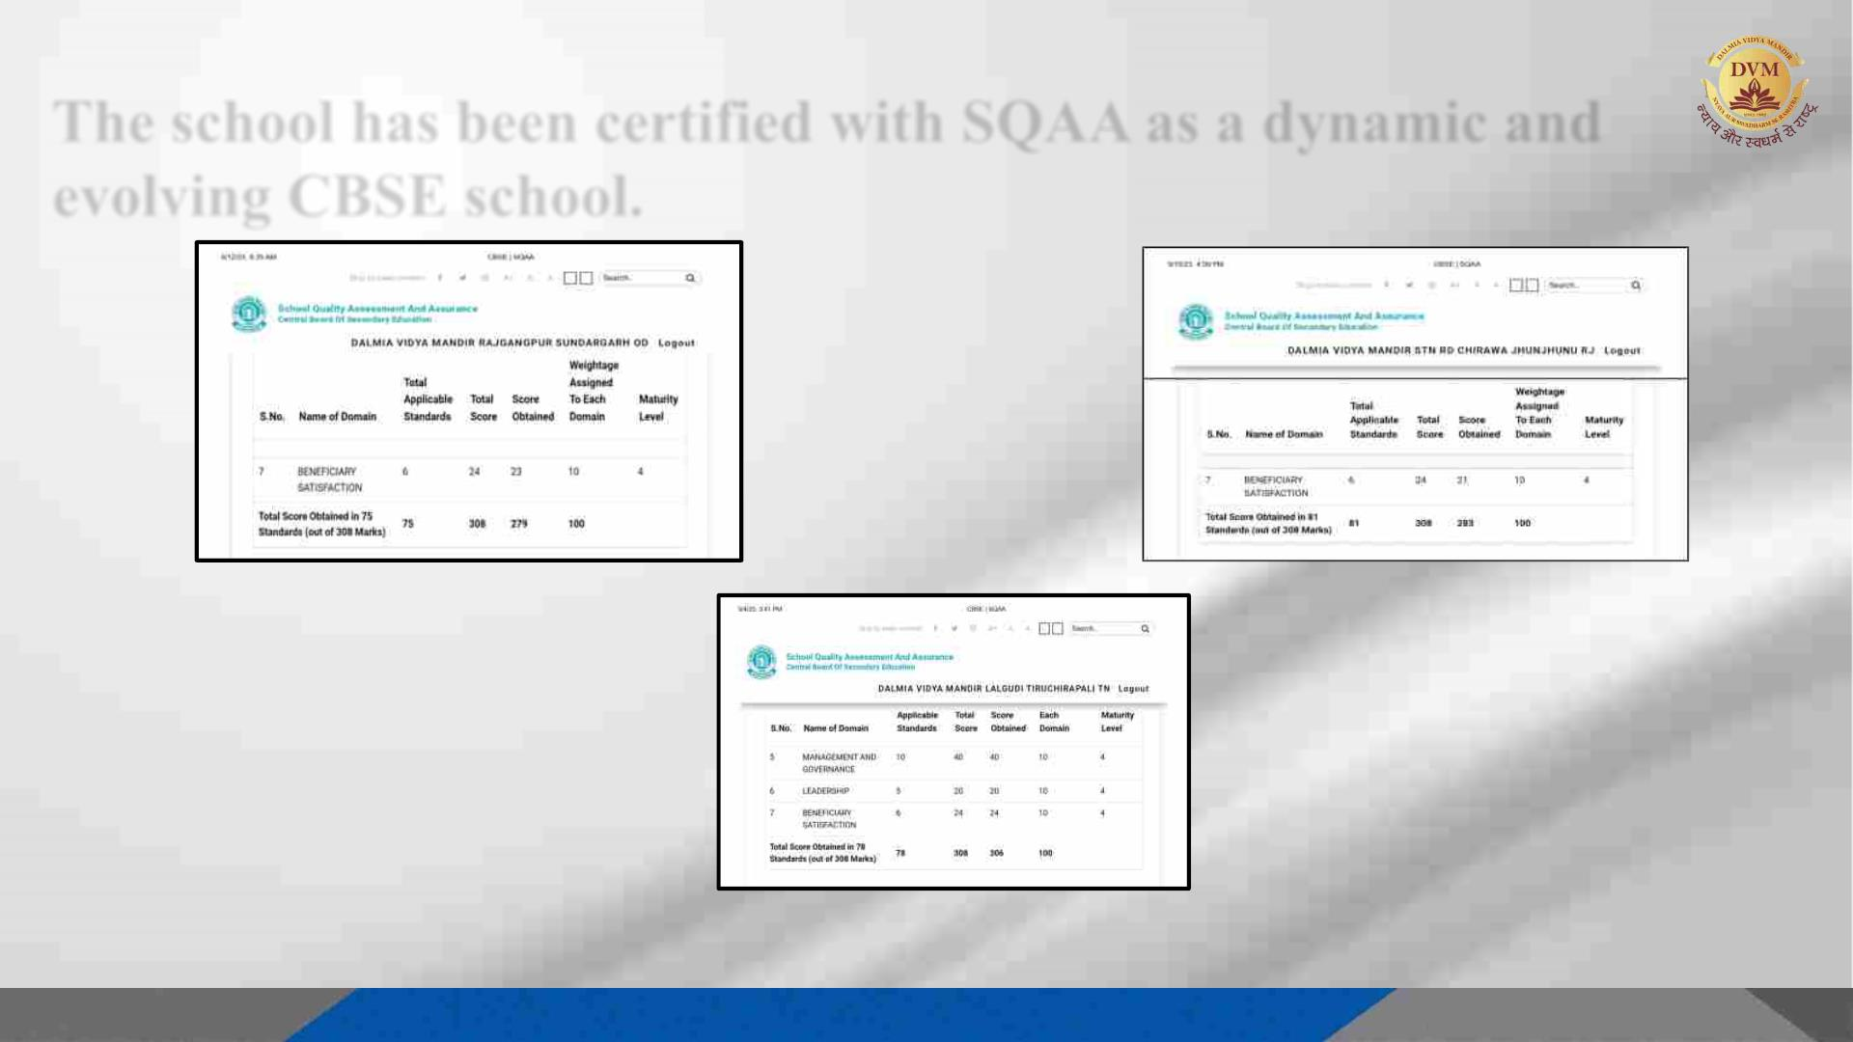
The school has been certified with SQAA as a dynamic and
evolving CBSE school.
Rajgangpur
Chirawa
Dalmiapuram

Slide 19

Summary
At Dalmia Vidya Mandir, we are committed to providing high-quality education to our
students and preparing them for success in the rapidly evolving world. In recognition of the
transformative age in which we live, we are dedicated not only to the education of our
students, but also to the professional development of our teachers at all levels. Our
implementation of cutting-edge technologies such as Smart Class and ERP LMS is just the
beginning of our efforts to create a technologically advanced and forward-thinking school.
Through the expansion of our school to remote areas, we aim to provide students with the best
possible education, leveraging the latest technological advancements. Additionally, our free
school in Dalmiapuram and NIOS centers are initiatives that ensure no child is left behind in
their education. To maintain a sense of cultural stability, we also offer the Bharat Gaurav
curriculum and oral Sanskrit to keep our students connected to their roots.
Furthermore, we are committed to environmental preservation, as evidenced by our DVM
Rajgangpur winning the Green School Award.

Slide 20

Visit us at:
www.dalmiavidyamandir.education

