Slide 1

DALMIA VIDYA MANDIR
DALMIAPURAM
CBSE Co – Educational School
Affiliation No :1931040
FEEDBACK FROM PARENTS

Slide 2

Student Name :Shri Santhoshi Praba. G, Grade 4B
Parent Name : Saranya Ganesh Kumar
Mobile number :9976726083
Namesthay teacher. I am Saranya Ganesh kumar.. mother of G.shri santhoshi praba she is studying 4th std B sec in dalmia vidya mandir school, Dalmia puram. I appreciate the teachers and staffs of dalmia vidya mandir school. Definitely it is very good options during this tough times. As a parent i am also being learning a lot from the classes. It's also giving me opportunity to work more closely with my daughter. I truly appreciate the efforts and this initiative that has been taken at this period lock down. The classes were so good the teachers were so hard working. Video classes were so attactive.also they are giving weekly once lock down activity. In watts app group they are sending the Hindu news paper and every day home work subject 's videos etc ....... so thanks to dvm school
GRADE IV – A & B
Student Name: Akshita.A, Grade 4B
Parent Name :Arun Kumar
Mobile number :7094785059
Hi everyone
Am a father of Akshita . She is studying class 4 section ‘ B’ in dalmiya Vidya mandir board of CBSE.
In my point of view the scholl is very nice . Same well as staff & principal handling the students is highly appreciated.
Specially this pandemic time the online courses is highly useful for all students.
I hope with in couple of years “ Dalmiya scholl CBSE “ will become a no : 1 position in all India level .
My support & my family support always with yours school.
Take care & wish you all the best.

Slide 3
Student Name:Devdarshan B. L, Grade 4B
Parent Name : Lalitha Babu
Mobile number :9688222325
Dear Miss,this is Mrs. Lalitha Babu, parent of B.L.Devdarshan, IV-B.I am very happy to share this message about your esteemed school... Daily activity and Homework make children to learn more even in this lockdown. Teachers co operating and making children to grew up compare to other schools. Thank you...
Student Name :Karunyashree, Grade 4B
Parent Name: Dhanalakshmi
Mobile number :7904142855
Namastai ! Welcome to dalmia vidhya mandir dalmia puram the are good performance of the teacher and students of dalmia vidhya mandir . The lockdown activity was nice and interesting , the sports also good and the online classes was superb thankyou.

Slide 4
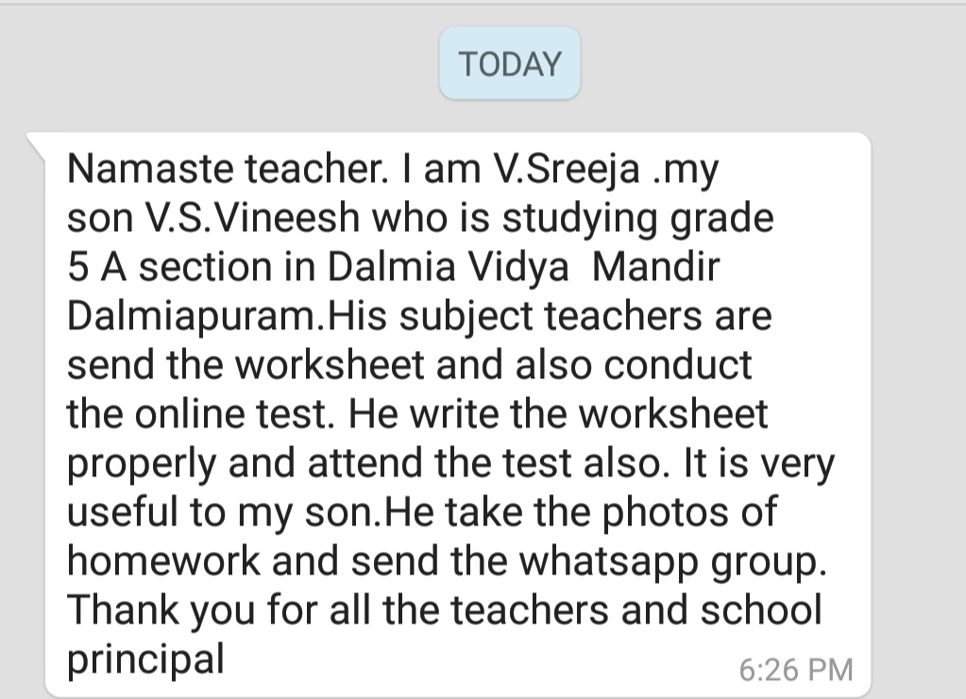
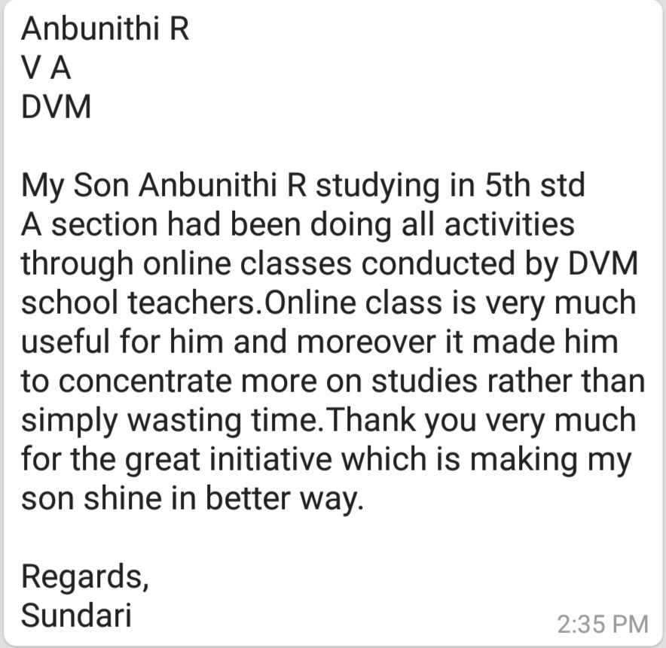
GRADE V – A& B
R.Anbunithi , Grade 5 A, S/O Sundari.
Phone number: 8248230760
V.S.Vineesh ,Grade 5 A, S/O V.Sreeja
Phone number : 9095147634

Slide 5
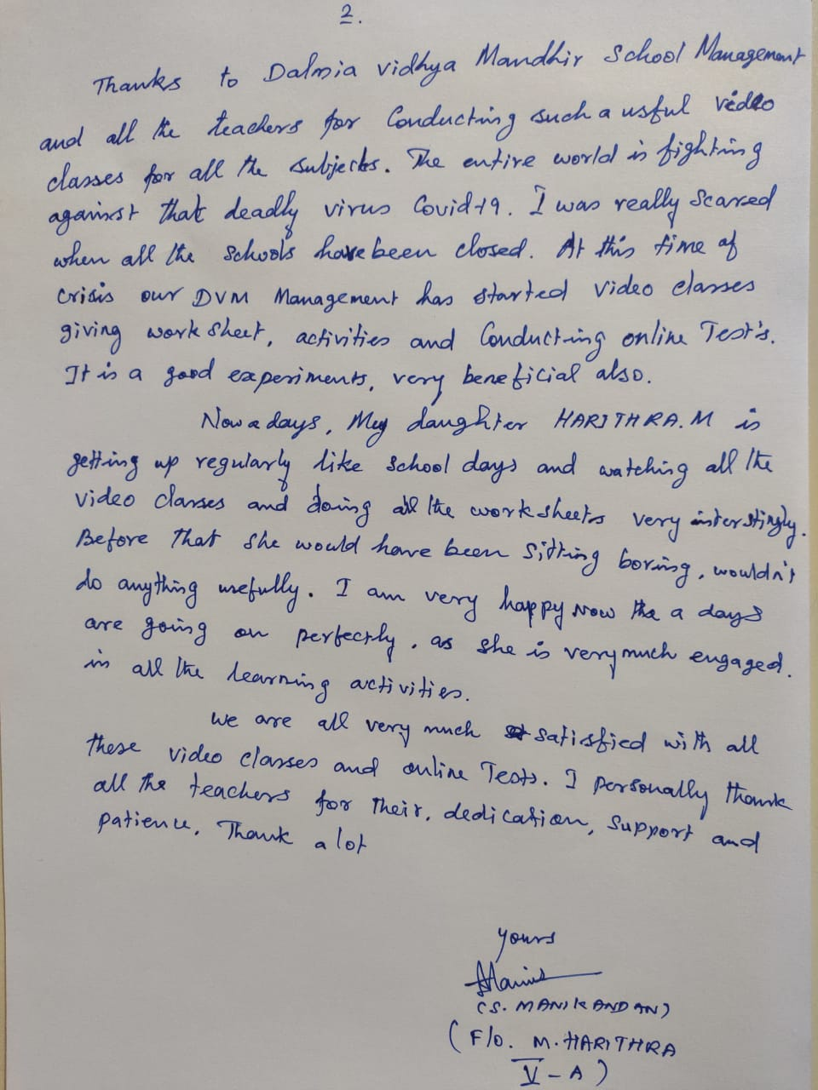
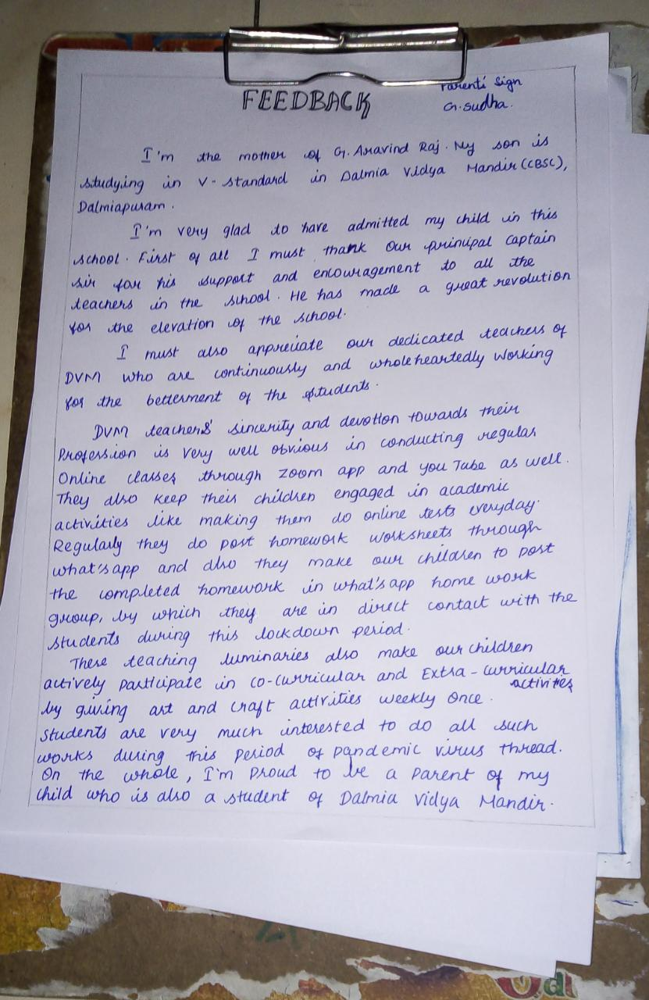
M.Harithra ,Grade 5 A,D/O C.S.Manikandan. Phone number : 9791874069
G.Aravind Raj ,Grade 5A, S/o G.Sudha.
Phone number : 9750279360

Slide 6
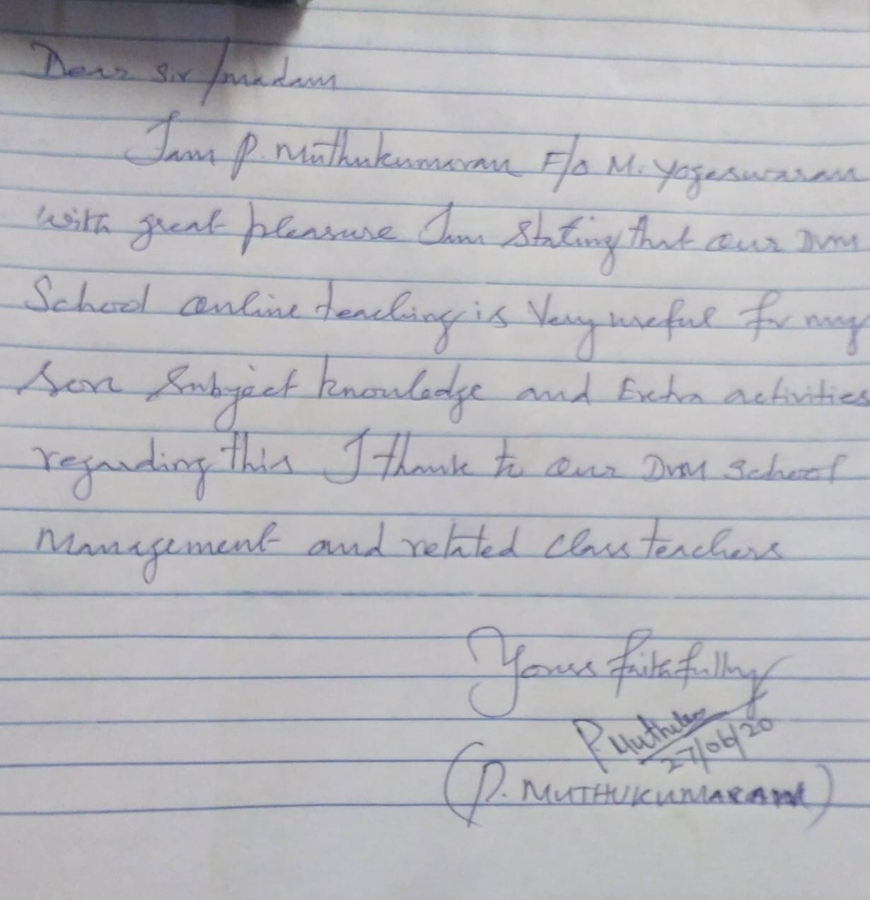
M.yogeshwaran,Grade 5 A,S/o P.Muthukumar. Phone number :7305016127
Aathis Narayanan,Grade 5 B,
Parents Name: N.KalyanaRaman.
V. Muthu Lakshmi.
Phone No.
86674 97262
Dear teachers,
Your designed an online classes are excellent.
Our children really enjoying the online classes.
We appreciate the thought it was well planned and layed.
The homework and online tests is enough for our children.
Our children like the weekend activities very much.
It's encourage our children talents.
Overall our children really like this online classes because all lectures, assignments, tests and activities are encourage them.
Really we appreciate your online classes during this lockdown period.
Thanks a lot to honorable Correspondent and teachers.
Thank you.

Slide 7
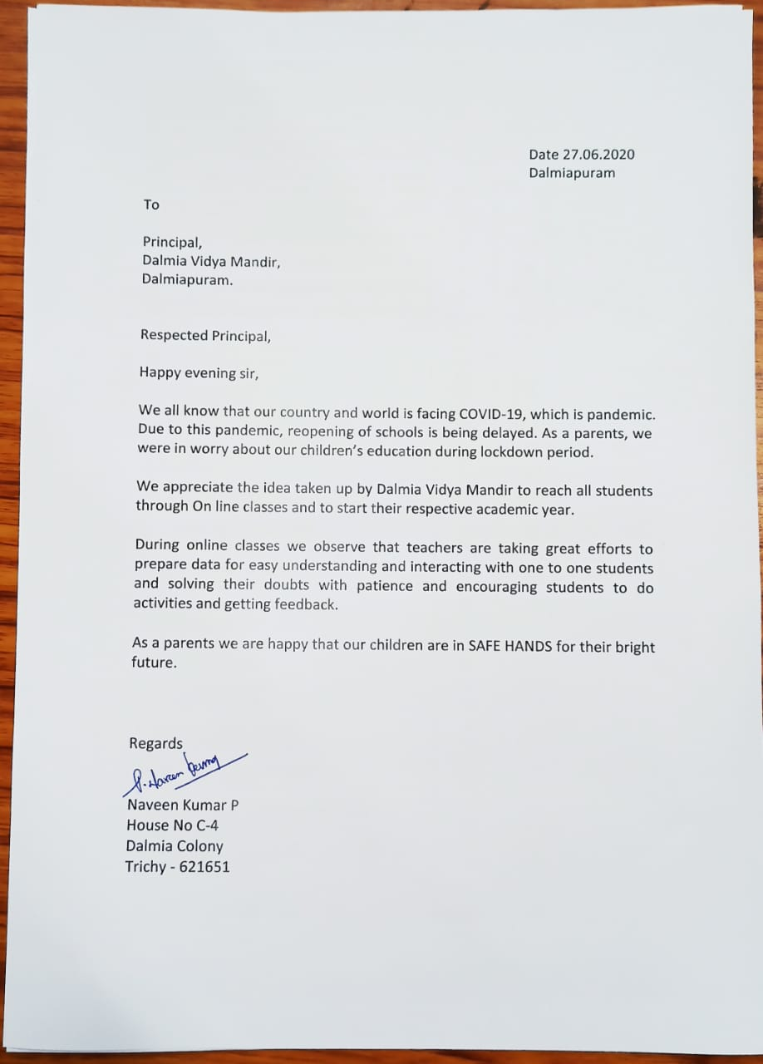
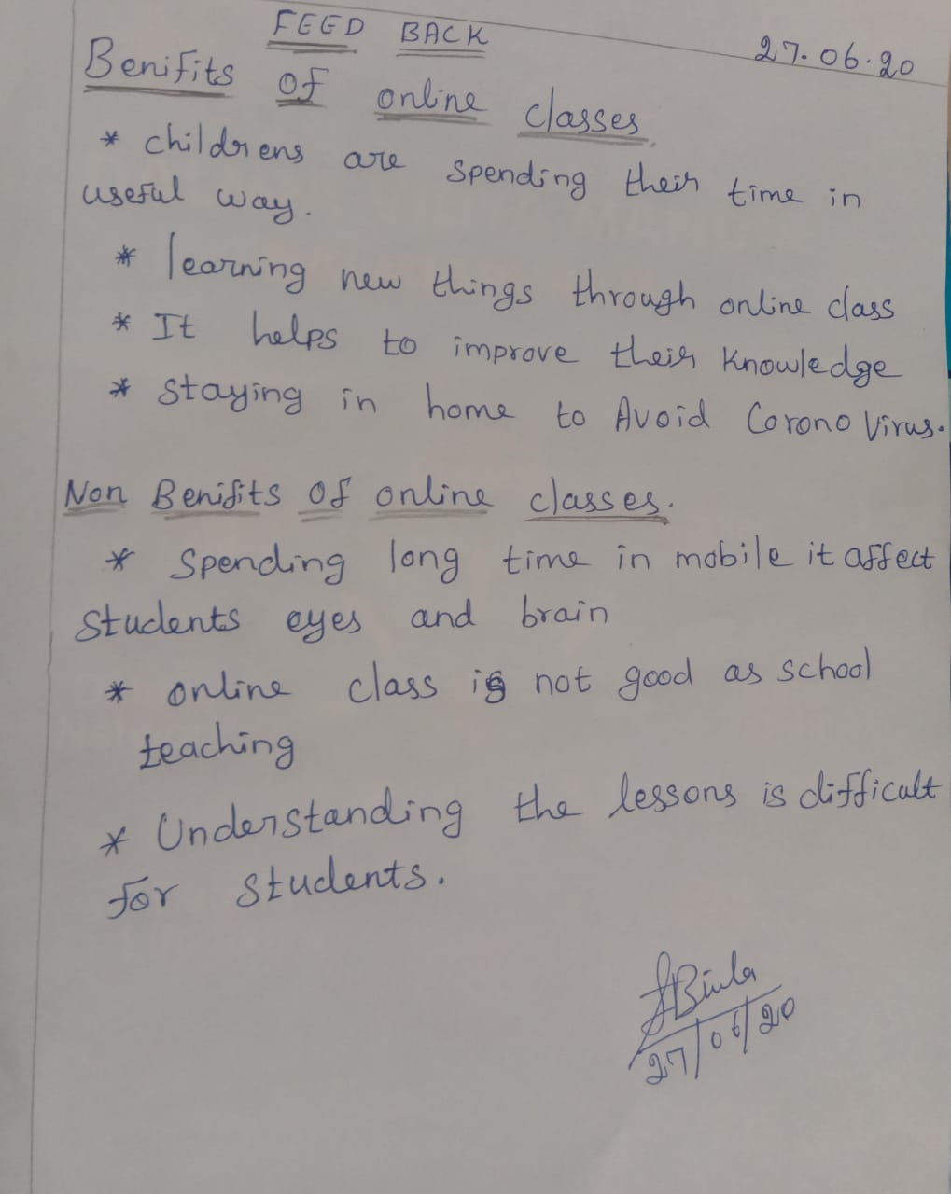
Pagadala Sudeeksha,Grade 5 A,D/o P.Naveen Kumar. Phone number: 9865166212
Harshika ,Grade 5A,D/o Biula Felix .
Phone number :9789528939

Slide 8
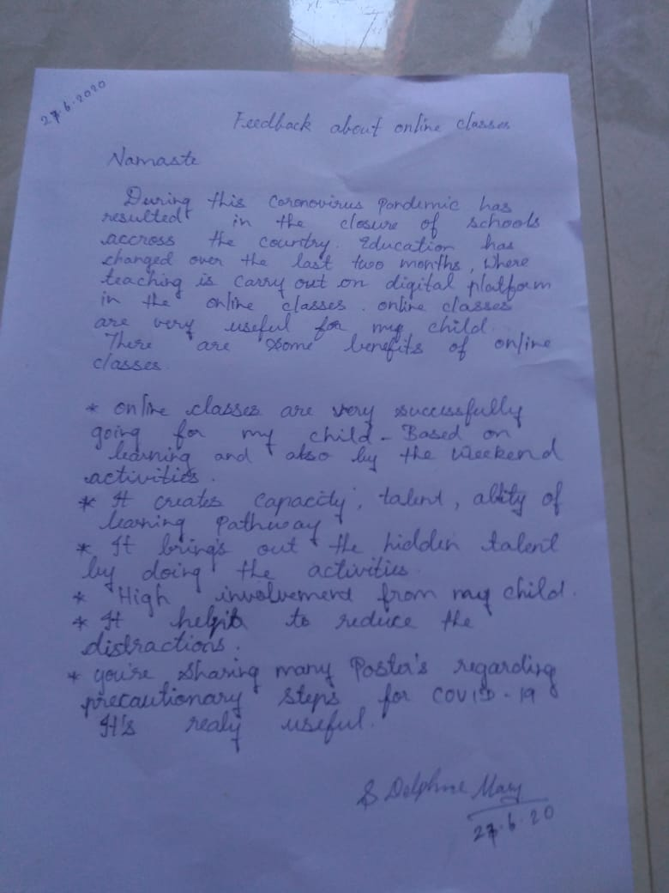
Robin, Grade 5A , S/o S.Delphine Mary. Phone number : 9788513049

Slide 9
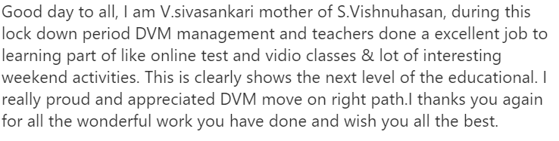
Grade VI – A & B
VISHNU HASSAN - VI A – S/O SIVASANKARI
PH: 8110981812

Slide 10
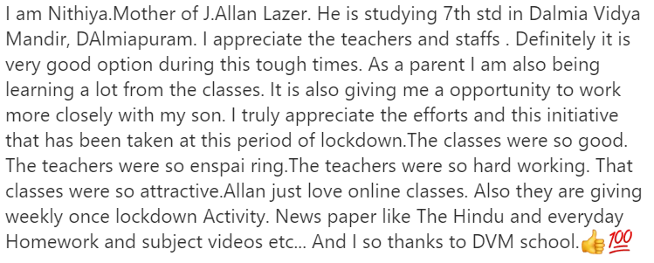
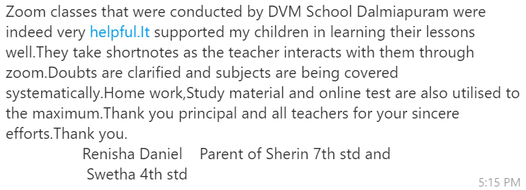
Grade VII – A & B
SHERIN R – VII – A D/O RENISHA DANIEL
PH: 9944390460
ALLAN LAZER J – VII – B - S/O NITHIYA
PH: 7598920349

Slide 11
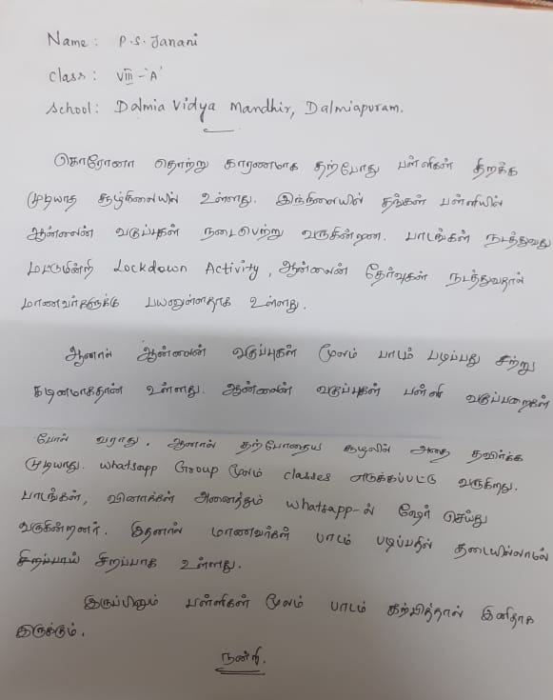
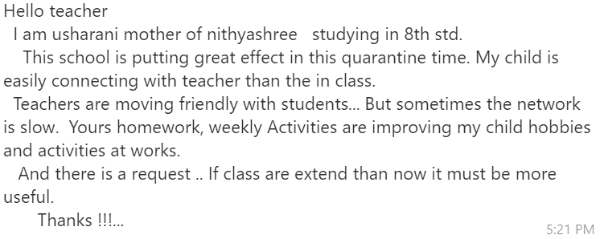
Grade VIII – A & B
NITHYASHREE – VIII – A – D/O USHA RANI
PH : 9443865023
P.S. JANANI – VIII – A – D/O SINDHIYA DEVI.T
PH :9942481000

Slide 12
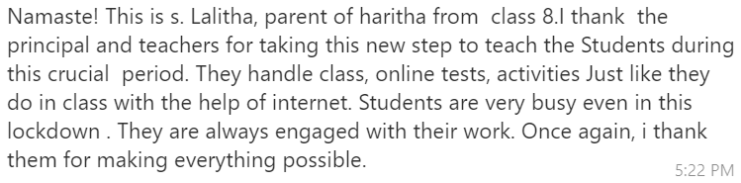
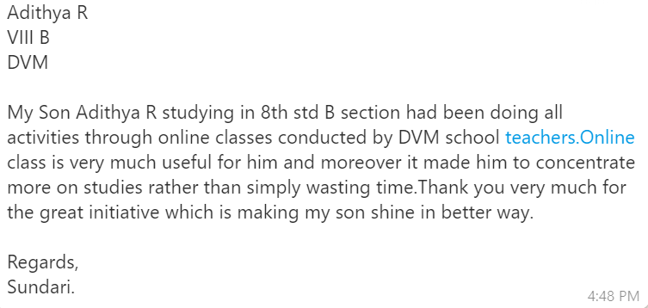
HARITHA – VIII – A – D/O LALITHA.S
PH : 9597806359
ADITHYA R – VIII – B – S/O SUNDARI
PH: 8248230760

Slide 13
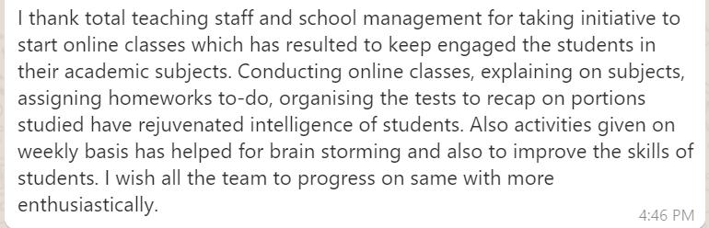
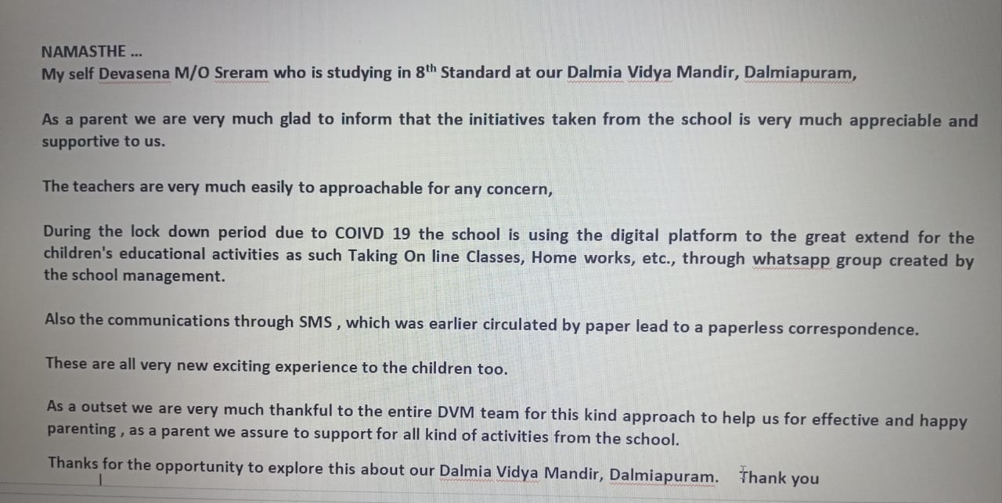
ROHAN M.shet - VIII B – S/O MANJUNATH Shet
PH:8105669779
SRERAM – VIII – B - S/O DEVASENA.B
PH:9566714199

Slide 14
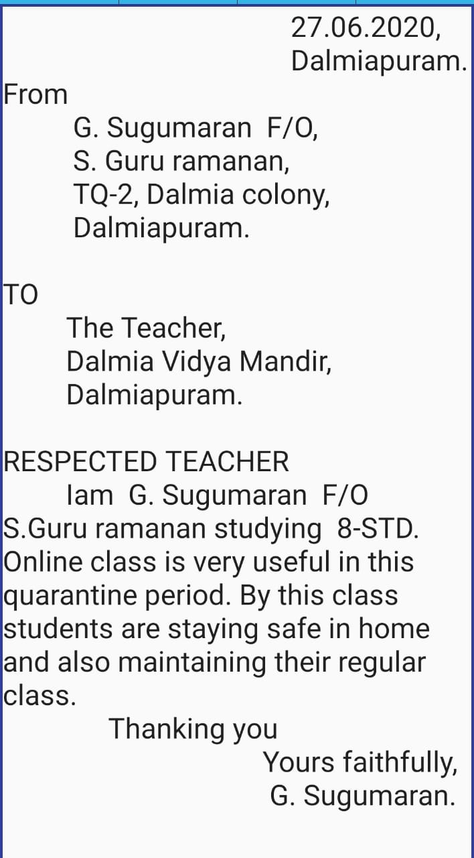
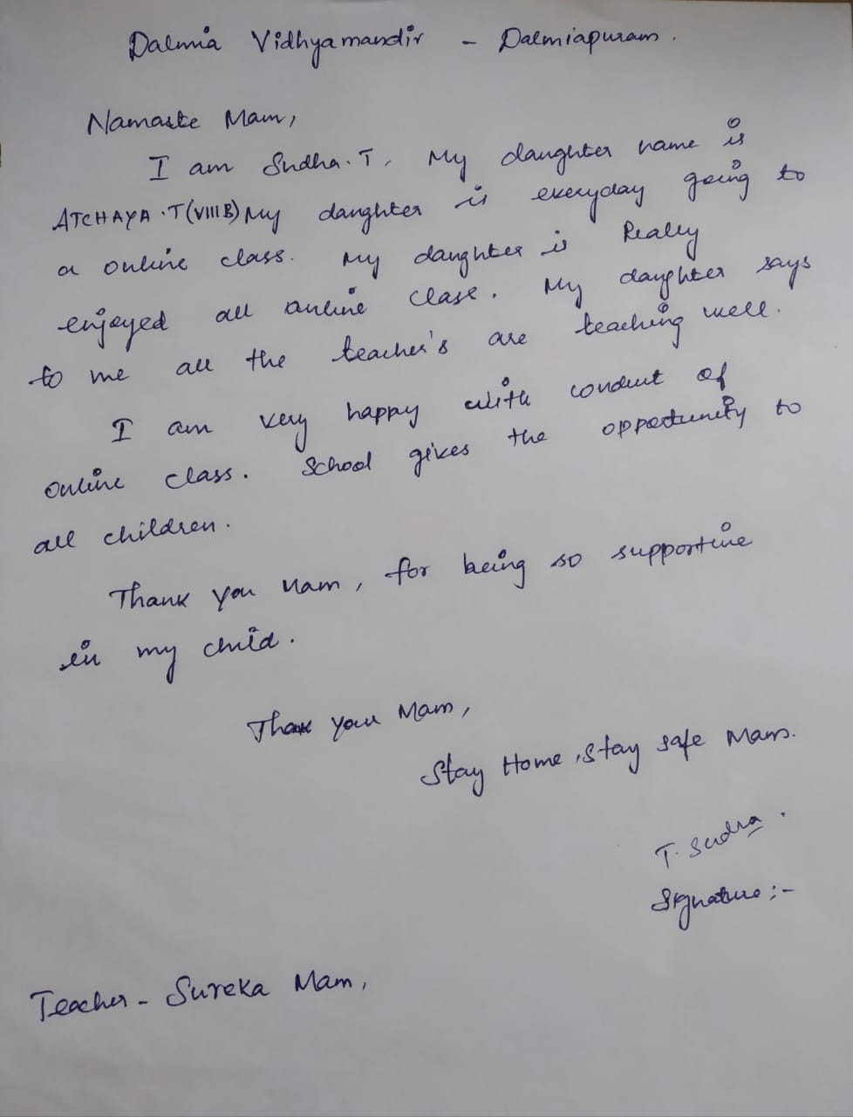
GURU RAMANAN – VIII - B – S/0 SUGUMARAN.G
PH: 9994302766
T.ATCHAYA – VIII – B - D/O SUDHA.T
PH: 9894466069

Slide 15
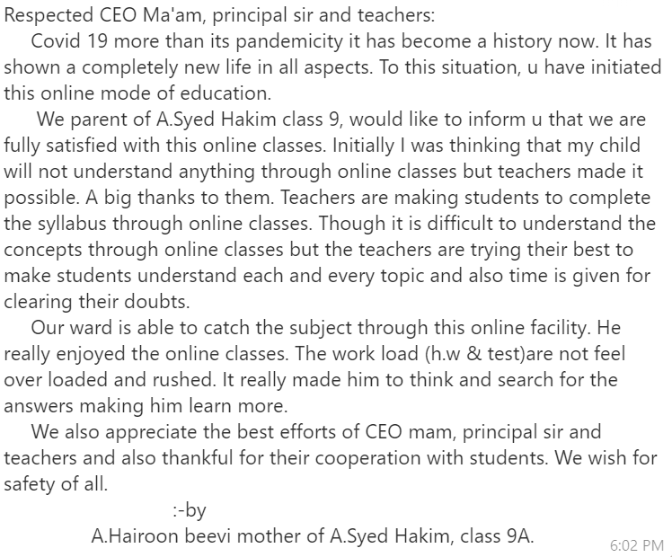
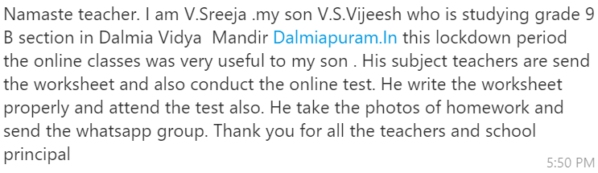
Grade IX – A & B
SYED HAKIM.A – IX - A - S/O HAIROON BEEVI.A
PH:
V. S. VIJEESH - IX-B – S/O SREEJA.V
PH: 9095147634

Slide 16
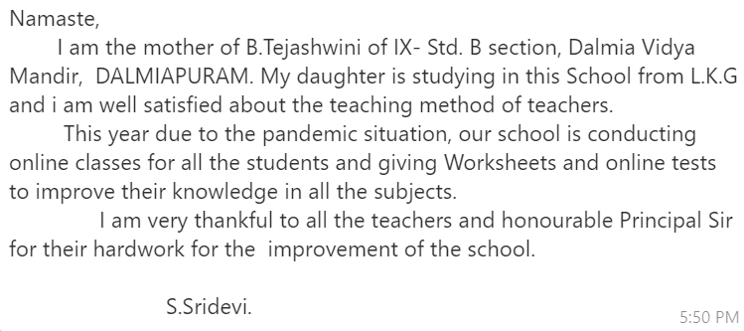
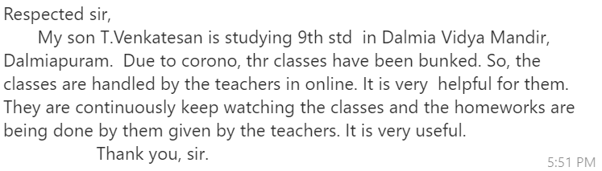
V. S. TEJASHWINI - IX-B – D/O SRIDEVI.S
PH: 9095834605
T. VENKATESAN - IX-B
PH: 9994496502

Slide 17
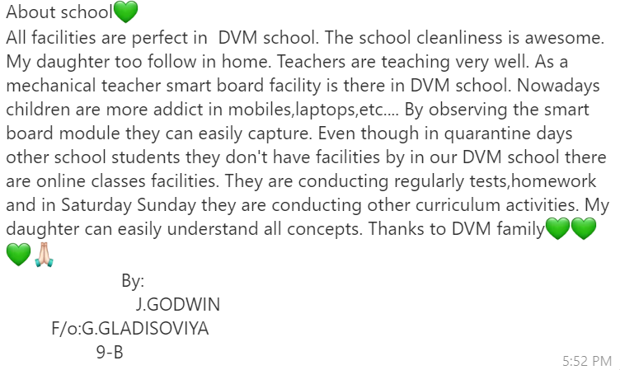
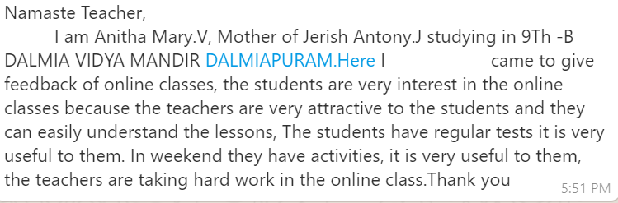
J. JERISH ANTONY - IX B – S/O ANITHA MARY
PH: 7904151794
GLASISOVIYA - IX-B – D/O GODWIN
PH: 9578739755

Slide 18
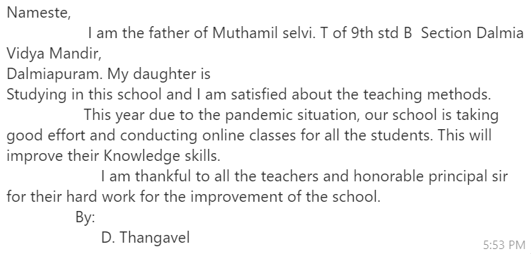
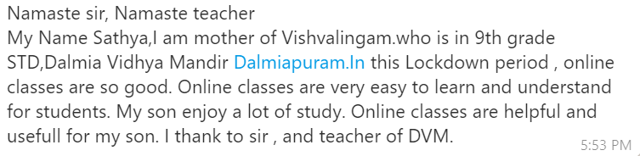
T. MUTHAMIL SELVI - IX-B – D/O THANGAVEL
PH: 9345730459
VISHVALINGAM.V – IX – S/O SATHYA
PH: 9788789516

Slide 19
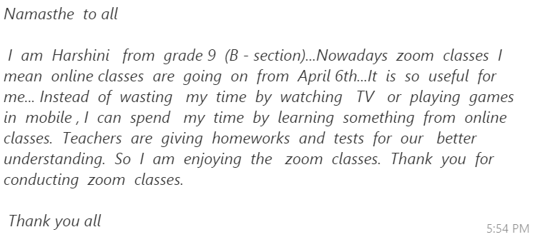
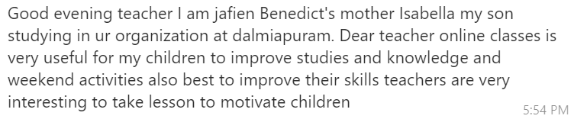
HARSHINI – IX – B
PH: 9715695292
JAFIEN BENEDICT – IX – S/O ISABELLA
PH: 9698558140

Slide 20
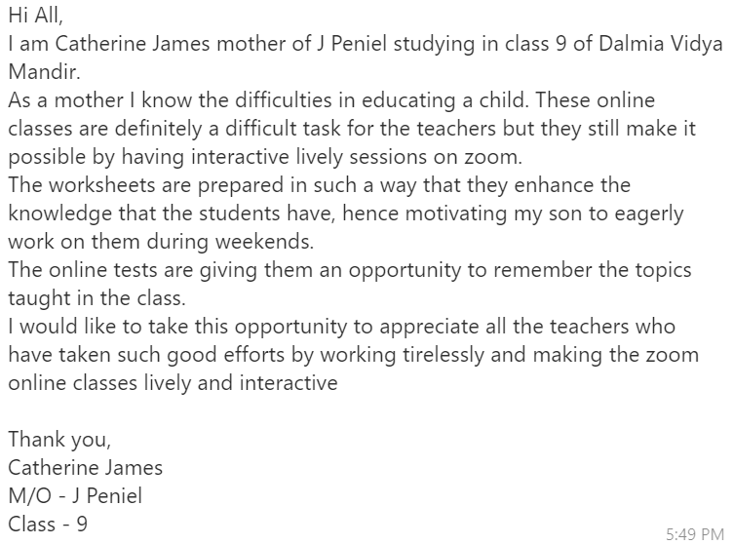
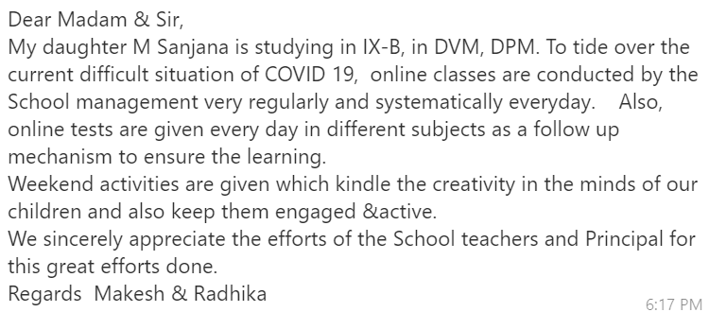
PENIEL J – IX – B - S/O CATHERINE JAMES
PH: 9943493716
SANJANA.M – IX – B – D/O MAKESH
PH: 9524077740

Slide 21
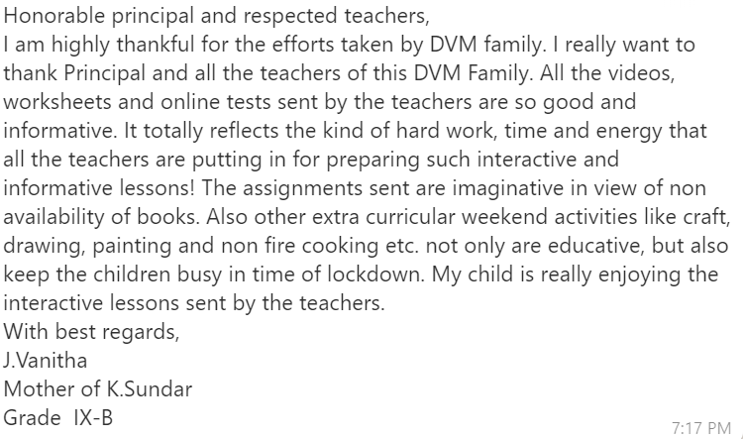
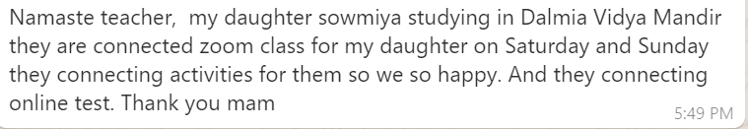
SUNDAR.K – IX – B – S/O VANITHA.J
PH: 9942086385
SOWMIYA– VIII – B
PH: 7871275794

