Slide 1

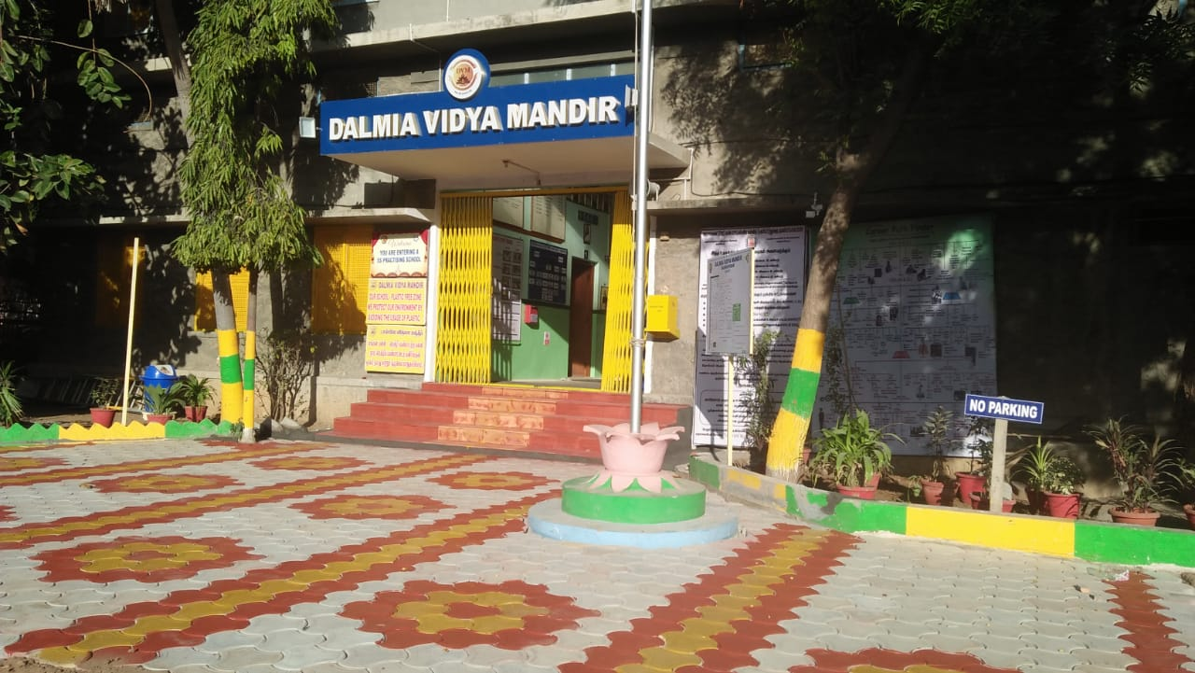
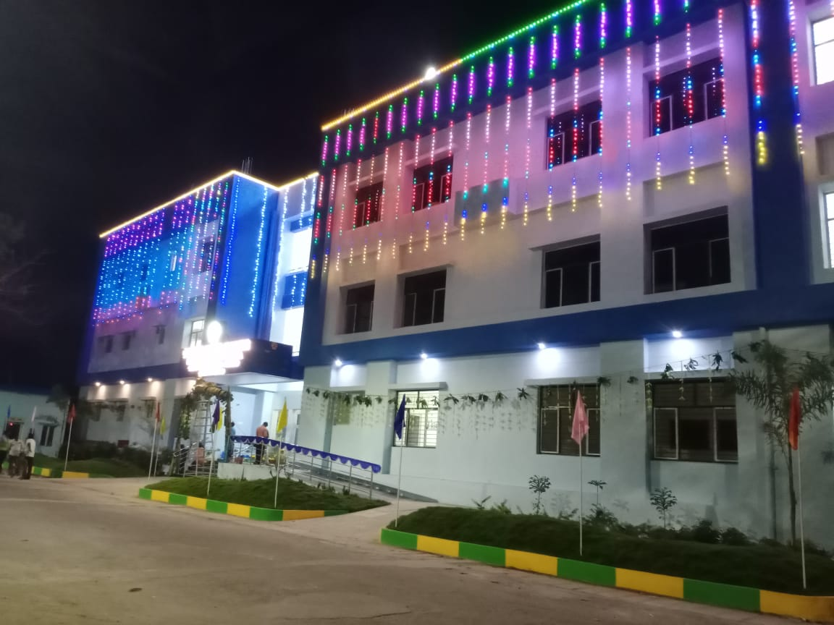
DALMIA VIDYA MANDIR – SENIOR SECONDARY SCHOOL
DALMIAPURAM

Slide 2
ADMINISTRATIVE SKILLS

Slide 3
WHAT IS ADMINISTRATION?
Administration is defined as the act of managing duties, responsibilities, or rules.
Administration is the act of the principal in the school - managing the faculty and staff and employing the rules of the school system.

Slide 4
What are the functions of school administration?
Administration has exciting leadership opportunities, which often play large roles in
Forming curriculums
Goal Setting in all aspects
Formulation of budgets
Fixing timelines
Following the State regulations
Ensure mandatory compliances and testing
Performance measures to ensure all educators are able to meet personal and professional goals.

Slide 5
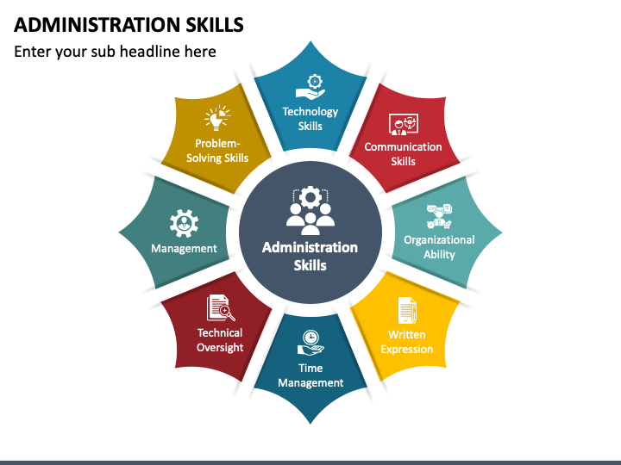

Slide 6
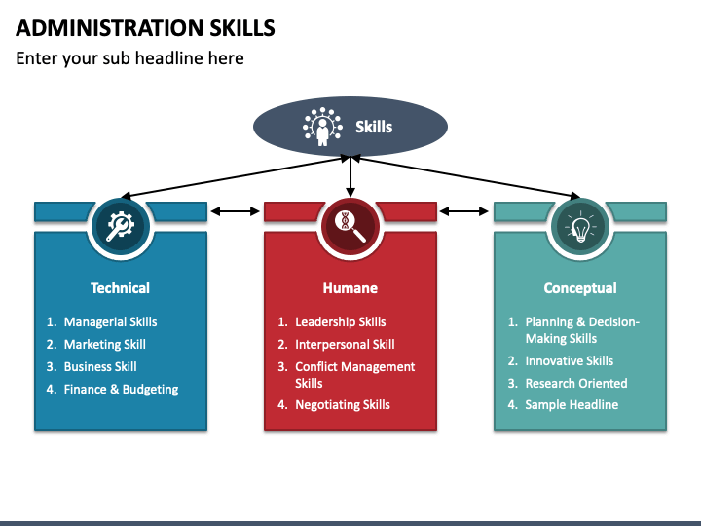

Slide 7
Qualities of a leader for a GOOD ADMINISTRATION
Has broad mindset
Develops strategies
Is Effective in interpersonal Communication
Gathers and assimilates information
Initiates tasks with planning
Connects and empathizes with others
Sets Goals
Has lucid vision
Believes in and practices teamwork
Nurtures innovation
Is a strong role model.
Strives for excellence.
Ready to take risks
Adapts to change
Inspires and motivates others
Brings conducive changes
Learns from success and failure

Slide 8
ADMINISTRATIVE LEADERSHIP ASPECT
Administrative Leadership Aspect
Appropriate governments rules and regulations
Prevalent National Curriculum Framework
National Education Policy
Admission & Promotion Policies for students
Disciplinary Procedures
Fee Structures
Safe environment for learners
Inclusion

Slide 9
About Code of Conduct for teaching and non-teaching Staff
Recruitment Policy
Rights and Responsibilities
Leave and Promotion Procedures
Information regarding Inclusive Education
Do’s & Don’ts within school
Safety of students
Annual Appraisals and Documentation

Slide 10
About Code of Conduct for Students:
Adherence to Discipline Policy of School
Respect for Uniform, School Rules, Staff, School Property, etc.
Submission of Assignments, Home Work
Penalties for Mis-conduct
Regularity and Punctuality

Slide 11
About Supreme Court Guidelines for School Transport
Transport Protocol
Ensuring Vendors adhere to RTO Guidelines
Police Verification & POCSO of Transport Department
Documentation related to vendoring / taxes / insurance
Bus Fitment Certificate

Slide 12
About School Management Committee
Constitution of SMC as per CBSE Affiliation Byelaws
Roles and Responsibilities of Members
Election and Nomination Process
Recording Minutes of the Meeting

Slide 13
About Provident Fund/ ESI:
• Ensuring remittance as per norms
• Withdrawal and Transfer Procedure of PF

Slide 14
ABOUT AUDITS AND SURVEILLANCE
Conduct of Internal & External Audits (ISO / CBSE / Accounts Deptt.) pertaining to finances, pedagogy documentation, safety, vigilance, salaries, etc.

Slide 15
About Evacuation Procedures
Devising evacuation plan and conducting drills regularly.
• Ensuring entry & exits in buildings are free and flowing.
• Emergency protocol for all Heads pertaining to medical, earthquake, fire, terrorists, etc.
• Important contacts in case of disaster

Slide 16
About Students Dossiers:
All records in hard & soft copy for each student separately
• Documents to be filed in dossiers – Admission Form, Date of Birth Certificate, Parents Residence Proof, Undertakings, Vaccination Chart, SC, ST, EWS proof, every year’s report card copy
• Transfer certificates
• Achievements record of students
• Indiscipline records (Absenteeism / bullying / cheating / bringing costly gadgets or cash to school, improper uniform, disrespect to teachers or school property, etc.)
• Annual health check-ups and fitness records as per para 14.6 of Affiliation Byelaws and other CBSE circulars

Slide 17
About Staff Files:
Recruitment form
• Copies of Aadhar card, Residence Proof, Date of Birth, Qualifications, Experience Certificates, NOC, Reference Letters, Medical Fitness
• Copies of participation in workshops, Seminars, Conferences
• Police Verification Proof & POCSO affidavit
• Annual leave record of EL, CL, Maternity or Paternity leave or on duty leave
• Annual Appraisal form • Classroom teaching observation reports by Heads
• Advisory / Memo / Warning / Office Order copy

Slide 18
About Documents pertaining to Infrastructure
Procuring and maintaining documents pertaining to Land Deeds, Building Plan, NOC from State Govt.
Regular updating of water potability, Health, Fire, Sanitation certificates
24x7 Electric supply
Compliance with para14.15 regarding facilitation of disabled students

Slide 19
About Safety & Security
Maintenance of pakka boundary wall
Maintenance of CCTV camera & surveillance room
Ensuring construction work is not safety hazards for students
Police verification of all employees in the school
Maintenance of firefighting systems and replacement of fire cylinders annually
Vector control management systems – Fogging, Pest Control
Ensuring clean and regular drinking water at all times and annual cleaning of overhead storage tanks + AMC of water coolers
Cyber safety guidelines

Slide 20
About School Finances & Accounting
Fee structure as per State & Central guidelines
Income Expenditure budgeting annually
Vendoring and tendering process
Reconciliation with bank
Planned and unplanned expenditure details

Slide 21
About Procurement Procedures
Furniture & fixtures
Sports equipment & goods
Electrical, Carpentry and Plumbing
Computer software & hardware
Stationery, Art & Craft
Books, Journals & Magazines
Sanitation Items

Slide 22
About Condemnation Guidelines
• Constituting Annual Condemnation Board of each department
• Disposing & repair of items as per SOP

Slide 23
About Interacting with CBSE, Local Officials for official purposes:
Submitting online annually UDISE & OASIS data
Renewal of CBSE affiliation on time
Attending meetings, conferences, workshops
Providing information & data as and when required regarding LOC, staff data
Participation in socially relevant events, competitions, etc.
Documentation regarding relaxations for CWSN
Conduct of Board & Public Exams
Submission of online report of selfassessment on SQAA, SEWA Projects, Annual Pedagogical Plans

Slide 24
About use of Technology for educational planning, governance and teaching and learning
How to maintain student/teacher/ staff/school data?
• Website maintenance as per para 2.4.9 of CBSE Affiliation Byelaws
• DIKSHA
• Shiksha Vani
• Vidya Daan
• Preparing Annual Report in accordance with Affiliation Byelaws and uploading on website

Slide 25
Promotion of Environmental Conservation And Awareness
The school strives to promote conservation of the environment on their campus through
Rainwater harvesting
Segregation of waste at source
Recycling of organic waste
Proper disposal of waste including electronic waste
Use of energy saving and energy-efficient electrical equipment,
greening of campus,
Use of solar energy, education and awareness amongst children on environmental conservation and cleanliness, etc.

